Slide 1
Module 4: AWS Cloud Security
AWS Academy Cloud Foundations
Notes:
Welcome to Module 4: AWS Cloud Security.
Security is the highest priority at Amazon Web Services (AWS). AWS delivers a scalable cloud computing environment that is designed for high availability and dependability, while providing the tools that enable you to run a wide range of applications. Helping to protect the confidentiality, integrity, and availability of your systems and data is critical to AWS, and so is maintaining customer trust and confidence. This module provides an introduction to the AWS approach to security, which includes both the controls in the AWS environment and some of the AWS products and features customers can use to meet their security objectives.

Slide 2

Module overview
Topics
AWS shared responsibility model
AWS Identity and Access Management (IAM)
Securing a new AWS account
Securing accounts
Securing data on AWS
Working to ensure compliance
Activities
AWS shared responsibility model activity
Demo
Recorded demonstration of IAM
Lab
Introduction to AWS IAM
Knowledge check
Notes:
This module will address the following topics:
AWS shared responsibility model
AWS Identity and Access Management (IAM)
Securing a new AWS account
Securing accounts
Securing data on AWS
Working to ensure compliance
Additional security services and resources
Section one includes an educator-led activity on the AWS shared responsibility model.
Section two includes a recorded IAM demo, and the end of this same section there includes a hands-on lab that provides you with practice configuring IAM by using the AWS Management Console.
Finally, you will be asked to complete a knowledge check to test your understanding of the key concepts that are covered in this module.

Slide 3
Module objectives
After completing this module, you should be able to:
Recognize the shared responsibility model
Identify the responsibility of the customer and AWS
Recognize IAM users, groups, and roles
Describe different types of security credentials in IAM
Identify the steps to securing a new AWS account
Explore IAM users and groups
Recognize how to secure AWS data
Recognize AWS compliance programs
Notes:
After completing this module, you should be able to:
Recognize the shared responsibility model
Identify the responsibility of the customer and AWS
Recognize IAM users, groups, and roles
Describe different types of security credentials in IAM
Identify the steps to securing a new AWS account
Explore IAM users and groups
Recognize how to secure AWS data
Recognize AWS compliance programs

Slide 4
Section 1: AWS shared responsibility model
Module 4: AWS Cloud Security
Notes:
Introducing Section 1: AWS shared responsibility model.

Slide 5
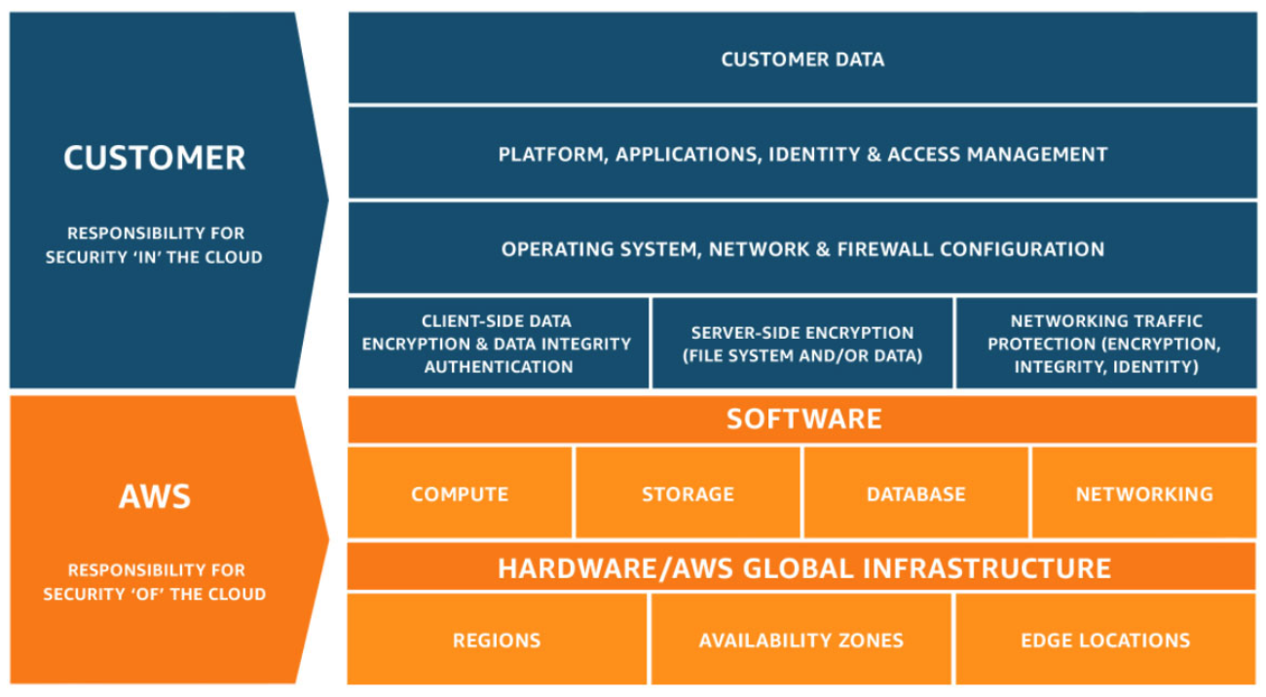
AWS shared responsibility model
Notes:
Security and compliance are a shared responsibility between AWS and the customer. This shared responsibility model is designed to help relieve the customer’s operational burden. At the same time, to provide the flexibility and customer control that enables the deployment of customer solutions on AWS, the customer remains responsible for some aspects of the overall security. The differentiation of who is responsible for what is commonly referred to as security “of” the cloud versus security “in” the cloud.
AWS operates, manages, and controls the components from the software virtualization layer down to the physical security of the facilities where AWS services operate. AWS is responsible for protecting the infrastructure that runs all the services that are offered in the AWS Cloud. This infrastructure is composed of the hardware, software, networking, and facilities that run the AWS Cloud services.
The customer is responsible for the encryption of data at rest and data in transit. The customer should also ensure that the network is configured for security and that security credentials and logins are managed safely. Additionally, the customer is responsible for the configuration of security groups and the configuration of the operating system that run on compute instances that they launch (including updates and security patches).

Slide 6








AWS responsibility: Security of the cloud
AWS responsibilities:
Physical security of data centers
Controlled, need-based access
Hardware and software infrastructure
Storage decommissioning, host operating system (OS) access logging, and auditing
Network infrastructure
Intrusion detection
Virtualization infrastructure
Instance isolation
AWS services
Compute
Storage
Database
Networking
AWS Global Infrastructure
Regions
Availability Zones
Edge locations
Notes:
AWS is responsible for security of the cloud. But what does that mean?
Under the AWS shared responsibility model, AWS operates, manages, and controls the components from the bare metal host operating system and hypervisor virtualization layer down to the physical security of the facilities where the services operate. It means that AWS is responsible for protecting the global infrastructure that runs all the services that are offered in the AWS Cloud. The global infrastructure includes AWS Regions, Availability Zones, and edge locations.
AWS is responsible for the physical infrastructure that hosts your resources, including:
Physical security of data centers with controlled, need-based access; located in nondescript facilities, with 24/7 security guards; two-factor authentication; access logging and review; video surveillance; and disk degaussing and destruction.
Hardware infrastructure, such as servers, storage devices, and other appliances that AWS relies on.
Software infrastructure, which hosts operating systems, service applications, and virtualization software.
Network infrastructure, such as routers, switches, load balancers, firewalls, and cabling. AWS also continuously monitors the network at external boundaries, secures access points, and provides redundant infrastructure with intrusion detection.
Protecting this infrastructure is the top priority for AWS. While you cannot visit AWS data centers or offices to see this protection firsthand, Amazon provides several reports from third-party auditors who have verified our compliance with a variety of computer security standards and regulations.

Slide 7
Customer responsibility: Security in the cloud
Customer responsibilities:
Amazon Elastic Compute Cloud (Amazon EC2) instance operating system
Including patching, maintenance
Applications
Passwords, role-based access, etc.
Security group configuration
OS or host-based firewalls
Including intrusion detection or prevention systems
Network configurations
Account management
Login and permission settings for each user
Customer data
Applications, IAM
Operating system, network, and firewall configuration
Client-side data
encryption and data integrity authentication
Server-side encryption
(file system or data)
Network traffic protection
(encryption, integrity, identity)
Customer-configurable
Notes:
While the cloud infrastructure is secured and maintained by AWS, customers are responsible for security of everything they put in the cloud.
The customer is responsible for what is implemented by using AWS services and for the applications that are connected to AWS. The security steps that you must take depend on the services that you use and the complexity of your system.
Customer responsibilities include selecting and securing any instance operating systems, securing the applications that are launched on AWS resources, security group configurations, firewall configurations, network configurations, and secure account management.
When customers use AWS services, they maintain complete control over their content. Customers are responsible for managing critical content security requirements, including:
What content they choose to store on AWS
Which AWS services are used with the content
In what country that content is stored
The format and structure of that content and whether it is masked, anonymized, or encrypted
Who has access to that content and how those access rights are granted, managed, and revoked
Customers retain control of what security they choose to implement to protect their own data, environment, applications, IAM configurations, and operating systems.

Slide 8






Service characteristics and security responsibility (1 of 2)
Example services managed by the customer
Infrastructure as a service (IaaS)
Customer has more flexibility over configuring networking and storage settings
Customer is responsible for managing more aspects of the security
Customer configures the access controls
Platform as a service (PaaS)
Customer does not need to manage the underlying infrastructure
AWS handles the operating system, database patching, firewall configuration, and disaster recovery
Customer can focus on managing code or data
Amazon EC2
Amazon Elastic Block Store (Amazon EBS)
Amazon Virtual Private Cloud (Amazon VPC)
Example services managed by AWS
AWS Lambda
Amazon Relational Database Service (Amazon RDS)
AWS Elastic Beanstalk
Notes:
Infrastructure as a service (IaaS) refers to services that provide basic building blocks for cloud IT, typically including access to configure networking, computers (virtual or on dedicated hardware), and data storage space. Cloud services that can be characterized as IaaS provide the customer with the highest level of flexibility and management control over IT resources. IaaS services are most similar to existing on-premises computing resources that many IT departments are familiar with today.
AWS services—such as Amazon EC2—can be categorized as IaaS and thus require the customer to perform all necessary security configuration and management tasks. Customers who deploy EC2 instances are responsible for managing the guest operating system (including updates and security patches), any application software that is installed on the instances, and the configuration of the security groups that were provided by AWS.
Platform as a service (PaaS) refers to services that remove the need for the customer to manage the underlying infrastructure (hardware, operating systems, etc.). PaaS services enable the customer to focus entirely on deploying and managing applications. Customers don’t need to worry about resource procurement, capacity planning, software maintenance, or patching.
AWS services such as AWS Lambda and Amazon RDS can be categorized as PaaS because AWS operates the infrastructure layer, the operating system, and platforms. Customers only need to access the endpoints to store and retrieve data. With PaaS services, customers are responsible for managing their data, classifying their assets, and applying the appropriate permissions. However, these service act more like managed services, with AWS handling a larger portion of the security requirements. For these services, AWS handles basic security tasks—such as operating system and database patching, firewall configuration, and disaster recovery.

Slide 9



Service characteristics and security responsibility (2 of 2)
SaaS examples
Software as a service (SaaS)
Software is centrally hosted
Licensed on a subscription model or pay-as-you-go basis.
Services are typically accessed via web browser, mobile app, or application programming interface (API)
Customers do not need to manage the infrastructure that supports the service
AWS Trusted
Advisor
AWS Shield
Amazon Chime
Notes:
Software as a service (SaaS) refers to services that provide centrally hosted software that is typically accessible via a web browser, mobile app, or application programming interface (API). The licensing model for SaaS offerings is typically subscription or pay as you go. With SaaS offerings, customers do not need to manage the infrastructure that supports the service. Some AWS services—such as AWS Trusted Advisor, AWS Shield, and Amazon Chime—could be categorized as SaaS offerings, given their characteristics.
AWS Trusted Advisor is an online tool that analyzes your AWS environment and provides real-time guidance and recommendations to help you provision your resources by following AWS best practices. The Trusted Advisor service is offered as part of your AWS Support plan. Some of the Trusted Advisor features are free to all accounts, but Business Support and Enterprise Support customers have access to the full set of Trusted Advisor checks and recommendations.
AWS Shield is a managed distributed denial of service (DDoS) protection service that safeguards applications running on AWS. It provides always-on detection and automatic inline mitigations that minimize application downtime and latency, so there is no need to engage AWS Support to benefit from DDoS protection. AWS Shield Advanced is available to all customers. However, to contact the DDoS Response Team, customers must have either Enterprise Support or Business Support from AWS Support.
Amazon Chime is a communications service that enables you to meet, chat, and place business calls inside and outside your organization, all using a single application. It is a pay-as-you-go communications service with no upfront fees, commitments, or long-term contracts.

Slide 10

Activity: AWS shared responsibility model
Photo by Pixabay from Pexels.
Notes:
In this educator-led activity, you will be presented with two scenarios. For each scenario, you will be asked several questions about whose responsibility it is (AWS or the customer) to ensure security of the item in question. The educator will lead the class in a discussion of each question and reveal the correct answers one at a time.

Slide 11




Activity: Scenario 1 of 2
Consider this deployment. Who is responsible – AWS or the customer?
AWS Cloud
Upgrades and patches to the operating system on the EC2 instance?
Physical security of the data center?
Virtualization infrastructure?
EC2 security group settings?
Configuration of applications that run on the EC2 instance?
Oracle upgrades or patches If the Oracle instance runs as an Amazon RDS instance?
Oracle upgrades or patches If Oracle runs on an EC2 instance?
S3 bucket access configuration?
Virtual Private Cloud (VPC)
Amazon Simple Storage Service (Amazon S3)
Amazon EC2
Oracle instance
AWS Global Infrastructure
Notes:
Consider the case where a customer uses the AWS services and resources that are shown here. Who is responsible for maintaining security? AWS or the customer?

Slide 12
Activity: Scenario 1 of 2 Answers
Consider this deployment. Who is responsible – AWS or the customer?
AWS Cloud
Upgrades and patches to the operating system on the EC2 instance?
ANSWER: The customer
Physical security of the data center?
ANSWER: AWS
Virtualization infrastructure?
ANSWER: AWS
EC2 security group settings?
ANSWER: The customer
Configuration of applications that run on the EC2 instance?
ANSWER: The customer
Oracle upgrades or patches If the Oracle instance runs as an Amazon RDS instance?
ANSWER: AWS
Oracle upgrades or patches If Oracle runs on an EC2 instance?
ANSWER: The customer
S3 bucket access configuration?
ANSWER: The customer
Virtual Private Cloud (VPC)
Amazon Simple Storage Service (Amazon S3)
Amazon EC2
Oracle instance
AWS Global Infrastructure
Notes:
The customer uses Amazon Simple Storage Service (Amazon S3) to store data. The customer configured a virtual private cloud (VPC) with Amazon Virtual Private Cloud (Amazon VPC). The EC2 instance and the Oracle database instance that they created both run in the VPC.
In this example, the customer must manage the guest operating system (OS) that runs on the EC2 instance. Over time, the guest OS will need to be upgraded and have security patches applied. Additionally, any application software or utilities that the customer installed on the Amazon EC2 instance must also be maintained. The customer is responsible for configuring the AWS firewall (or security group) that is applied to the Amazon EC2 instance. The customer is also responsible for the VPC configurations that specify the network conditions in which the Amazon EC2 instance runs. These tasks are the same security tasks that IT staff would perform, no matter where their servers are located.
The Oracle instance in this example provides an interesting case study in terms of AWS or customer responsibility. If the database runs on an EC2 instance, then it is the customer's responsibility to apply Oracle software upgrades and patches. However, if the database runs as an Amazon RDS instance, then it is the responsibility of AWS to apply Oracle software upgrades and patches. Because Amazon RDS is a managed database offering, time-consuming database administration tasks—which include provisioning, backups, software patching, monitoring, and hardware scaling—are handled by AWS. To learn more, see Best Practices for Running Oracle Database on AWS at https://docs.aws.amazon.com/whitepapers/latest/oracle-database-aws-best-practices/oracle-database-aws-best-practices.html for details.

Slide 13







Activity: Scenario 2 of 2
Consider this deployment. Who is responsible – AWS or the customer?
Secure Shell (SSH) keys
Ensuring that the AWS Management Console is not hacked?
Configuring the subnet?
Configuring the VPC?
Protecting against network outages in AWS Regions?
Securing the SSH keys
Ensuring network isolation between AWS customers' data?
Ensuring low-latency network connection between the web server and the S3 bucket?
Enforcing multi-factor authentication for all user logins?
AWS Command Line Interface (AWS CLI)
AWS Management Console
Internet gateway
VPC
Subnet
Web server on Amazon EC2
S3 bucket with objects
Notes:
Now, consider this additional case where a customer uses the AWS services and resources that are shown here. Who is responsible for maintaining security? AWS or the customer?

Slide 14
Activity: Scenario 2 of 2 Answers
Consider this deployment. Who is responsible – AWS or the customer?
Secure Shell (SSH) keys
Ensuring that the AWS Management Console is not hacked?
ANSWER: AWS
Configuring the subnet?
ANSWER: The customer
Configuring the VPC?
ANSWER: The customer
Protecting against network outages in AWS Regions?
ANSWER: AWS
Securing the SSH keys
ANSWER: The customer
Ensuring network isolation between AWS customers' data?
ANSWER: AWS
Ensuring low-latency network connection between the web server and the S3 bucket?
ANSWER: AWS
Enforcing multi-factor authentication for all user logins?
ANSWER: The customer
AWS Command Line Interface (AWS CLI)
AWS Management Console
Internet gateway
VPC
Subnet
Web server on Amazon EC2
S3 bucket with objects
Notes:
A customer uses Amazon S3 to store data. The customer configured a virtual private cloud (VPC) with Amazon VPC, and is running a web server on an EC2 instance in the VPC. The customer configured an internet gateway as part of the VPC so that the web server can be reached by using the AWS Management Console or the AWS Command Line Interface (AWS CLI). When the customer uses the AWS CLI, the connection requires the use of Secure Shell (SSH) keys.

Slide 15

Section 1 key takeaways
AWS and the customer share security responsibilities:
AWS is responsible for security of the cloud
Customer is responsible for security in the cloud
AWS is responsible for protecting the infrastructure—including hardware, software, networking, and facilities—that run AWS Cloud services
For services that are categorized as infrastructure as a service (IaaS), the customer is responsible for performing necessary security configuration and management tasks
For example, guest OS updates and security patches, firewall, security group configurations
Notes:
Some key takeaways from this section of the module include:
AWS and the customer share security responsibilities –
AWS is responsible for security of the cloud
Customer is responsible for security in the cloud
AWS is responsible for protecting the infrastructure—including hardware, software, networking, and facilities—that run AWS Cloud services
For services that are categorized as infrastructure as a service (IaaS), the customer is responsible for performing necessary security configuration and management tasks
For example, guest OS updates and security patches, firewall, security group configurations

Slide 16
Section 2: AWS Identity and Access Management (IAM)
Module 4: AWS Cloud Security
Notes:
Introducing Section 2: AWS Identity and Access Management (or IAM).

Slide 17

AWS Identity and Access Management (IAM)
Use IAM to manage access to AWS resources –
A resource is an entity in an AWS account that you can work with
Example resources; An Amazon EC2 instance or an Amazon S3 bucket
Example – Control who can terminate Amazon EC2 instances
Define fine-grained access rights –
Who can access the resource
Which resources can be accessed and what can the user do to the resource
How resources can be accessed
IAM is a no-cost AWS account feature
AWS Identity and Access Management
(IAM)
Notes:
AWS Identity and Access Management (IAM) allows you to control access to compute, storage, database, and application services in the AWS Cloud. IAM can be used to handle authentication, and to specify and enforce authorization policies so that you can specify which users can access which services.
IAM is a tool that centrally manages access to launching, configuring, managing, and terminating resources in your AWS account. It provides granular control over access to resources, including the ability to specify exactly which API calls the user is authorized to make to each service. Whether you use the AWS Management Console, the AWS CLI, or the AWS software development kits (SDKs), every call to an AWS service is an API call.
With IAM, you can manage which resources can be accessed by who, and how these resources can be accessed. You can grant different permissions to different people for different resources. For example, you might allow some users full access to Amazon EC2, Amazon S3, Amazon DynamoDB, Amazon Redshift, and other AWS services. However, for other users, you might allow read-only access to only a few S3 buckets. Similarly, you might grant permission to other users to administer only specific EC2 instances. You could also allow a few users to access only the account billing information, but nothing else.
IAM is a feature of your AWS account, and it is offered at no additional charge.

Slide 18




IAM: Essential components
A person or application that can authenticate with an AWS account.
IAM user
A collection of IAM users that are granted identical authorization.
IAM group
The document that defines which resources can be accessed and the level of access to each resource.
IAM policy
Useful mechanism to grant a set of permissions for making AWS service requests.
IAM role
Notes:
To understand how to use IAM to secure your AWS account, it is important to understand the role and function of each of the four IAM components.
An IAM user is a person or application that is defined in an AWS account, and that must make API calls to AWS products. Each user must have a unique name (with no spaces in the name) within the AWS account, and a set of security credentials that is not shared with other users. These credentials are different from the AWS account root user security credentials. Each user is defined in one and only one AWS account.
An IAM group is a collection of IAM users. You can use IAM groups to simplify specifying and managing permissions for multiple users.
An IAM policy is a document that defines permissions to determine what users can do in the AWS account. A policy typically grants access to specific resources and specifies what the user can do with those resources. Policies can also explicitly deny access.
An IAM role is a tool for granting temporary access to specific AWS resources in an AWS account.

Slide 19

Authenticate as an IAM user to gain access
When you define an IAM user, you select what types of access the user is permitted to use.
Programmatic access
Authenticate using:
Access key ID
Secret access key
Provides AWS CLI and AWS SDK access
AWS Management Console access
Authenticate using:
12-digit Account ID or alias
IAM user name
IAM password
If enabled, multi-factor authentication (MFA) prompts for an authentication code.
AWS CLI
AWS Tools and SDKs
AWS Management Console
Notes:
Authentication is a basic computer security concept: a user or system must first prove their identity. Consider how you authenticate yourself when you go to the airport and you want to get through airport security so that you can catch your flight. In this situation, you must present some form of identification to the security official to prove who you are before you can enter a restricted area. A similar concept applies for gaining access to AWS resources in the cloud.
When you define an IAM user, you select what type of access the user is permitted to use to access AWS resources. You can assign two different types of access to users: programmatic access and AWS Management Console access. You can assign programmatic access only, console access only, or you can assign both types of access.
If you grant programmatic access, the IAM user will be required to present an access key ID and a secret access key when they make an AWS API call by using the AWS CLI, the AWS SDK, or some other development tool.
If you grant AWS Management Console access, the IAM user will be required to fill in the fields that appear in the browser login window. The user is prompted to provide either the 12-digit account ID or the corresponding account alias. The user must also enter their IAM user name and password. If multi-factor authentication (MFA) is enabled for the user, they will also be prompted for an authentication code.

Slide 20

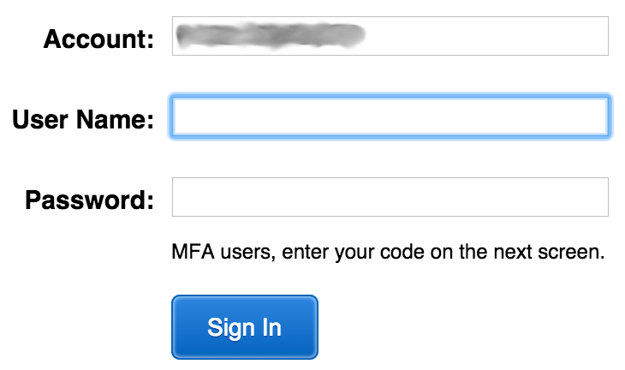

IAM MFA
MFA provides increased security.
In addition to username and password, MFA requires a unique authentication code to access AWS services.
Username and password
MFA token
AWS Management Console
Notes:
AWS services and resources can be accessed by using the AWS Management Console, the AWS CLI, or through SDKs and APIs. For increased security, we recommend enabling MFA.
With MFA, users and systems must provide an MFA token—in addition to the regular sign-in credentials—before they can access AWS services and resources.
Options for generating the MFA authentication token include virtual MFA-compliant applications (such as Google Authenticator or Authy 2-Factor Authentication), U2F security key devices, and hardware MFA devices.

Slide 21



Authorization: What actions are permitted
After the user or application is connected to the AWS account, what are they allowed to do?
EC2 instances
Full access
Read-only
IAM user, IAM group, or IAM role
S3 bucket
IAM policies
Notes:
Authorization is the process of determining what permissions a user, service or application should be granted. After a user has been authenticated, they must be authorized to access AWS services.
By default, IAM users do not have permissions to access any resources or data in an AWS account. Instead, you must explicitly grant permissions to a user, group, or role by creating a policy, which is a document in JavaScript Object Notation (JSON) format. A policy lists permissions that allow or deny access to resources in the AWS account.

Slide 22
IAM: Authorization
Assign permissions by creating an IAM policy.
Permissions determine which resources and operations are allowed:
All permissions are implicitly denied by default.
If something is explicitly denied, it is never allowed.
Best practice: Follow the principle of least privilege.
Note: The scope of IAM service configurations is global. Settings apply across all AWS Regions.
IAM permissions
Notes:
To assign permission to a user, group or role, you must create an IAM policy (or find an existing policy in the account). There are no default permissions. All actions in the account are denied to the user by default (implicit deny) unless those actions are explicitly allowed. Any actions that you do not explicitly allow are denied. Any actions that you explicitly deny are always denied.
The principle of least privilege is an important concept in computer security. It promotes that you grant only the minimal user privileges needed to the user, based on the needs of your users. When you create IAM policies, it is a best practice to follow this security advice of granting least privilege. Determine what users need to be able to do and then craft policies for them that let the users perform only those tasks. Start with a minimum set of permissions and grant additional permissions as necessary. Doing so is more secure than starting with permissions that are too broad and then later trying to lock down the permissions granted.
Note that the scope of the IAM service configurations is global. The settings are not defined at an AWS Region level. IAM settings apply across all AWS Regions.

Slide 23
IAM policies
An IAM policy is a document that defines permissions
Enables fine-grained access control
Two types of policies – identity-based and resource-based
Identity-based policies –
Attach a policy to any IAM entity
An IAM user, an IAM group, or an IAM role
Policies specify:
Actions that may be performed by the entity
Actions that may not be performed by the entity
A single policy can be attached to multiple entities
A single entity can have multiple policies attached to it
Resource-based policies
Attached to a resource (such as an S3 bucket)
IAM entities
Attach to one of
IAM user
IAM policy
IAM group
IAM role
Notes:
An IAM policy is a formal statement of permissions that will be granted to an entity. Policies can be attached to any IAM entity. Entities include users, groups, roles, or resources. For example, you can attach a policy to AWS resources that will block all requests that do not come from an approved Internet Protocol (IP) address range. Policies specify what actions are allowed, which resources to allow the actions on, and what the effect will be when the user requests access to the resources.
The order in which the policies are evaluated has no effect on the outcome of the evaluation. All policies are evaluated, and the result is always that the request is either allowed or denied. When there is a conflict, the most restrictive policy applies.
There are two types of IAM policies. Identity-based policies are permissions policies that you can attach to a principal (or identity) such as an IAM user, role, or group. These policies control what actions that identity can perform, on which resources, and under what conditions. Identity-based policies can be further categorized as:
Managed policies – Standalone identity-based policies that you can attach to multiple users, groups, and roles in your AWS account
Inline policies – Policies that you create and manage, and that are embedded directly into a single user group or role.
Resource-based policies are JSON policy documents that you attach to a resource, such as an S3 bucket. These policies control what actions a specified principal can perform on that resource, and under what conditions.

Slide 24

IAM policy example
{
"Version": "2012-10-17",
"Statement":[{
"Effect":"Allow",
"Action":["DynamoDB:*","s3:*"],
"Resource":[ "arn:aws:dynamodb:region:account-number-without-hyphens:table/table-name",
"arn:aws:s3:::bucket-name",
"arn:aws:s3:::bucket-name/*"]
},
{
"Effect":"Deny",
"Action":["dynamodb:*","s3:*"],
"NotResource":["arn:aws:dynamodb:region:account-number-without-hyphens:table/table-name”,
"arn:aws:s3:::bucket-name",
"arn:aws:s3:::bucket-name/*"]
}
]
}
Explicit allow gives users access to a specific DynamoDB table and…
…Amazon S3 buckets.
Explicit deny ensures that the users cannot use any other AWS actions or resources other than that table and those buckets.
An explicit deny statement takes precedence over an allow statement.
Notes:
As mentioned previously, IAM policy documents are written in JSON.
The example IAM policy grants users access only to the following resources:
The DynamoDB table whose name is represented by table-name.
The AWS account's S3 bucket, whose name is represented by bucket-name and all the objects that it contains.
The IAM policy also includes an explicit deny ("Effect":"Deny") element. The NotResource element helps to ensure that users cannot use any other DynamoDB or S3 actions or resources except the actions and resources that are specified in the policy—even if permissions have been granted in another policy. An explicit deny statement takes precedence over an allow statement.

Slide 25


Resource-based policies
Identity-based policies are attached to a user, group, or role
Resource-based policies are attached to a resource (not to a user, group or role)
Characteristics of resource-based policies –
Specifies who has access to the resource and what actions they can perform on it
The policies are inline only, not managed
Resource-based policies are supported only by some AWS services
AWS Account
IAM user MaryMajor
S3 bucket photos
attached
Defined inline
on the bucket
Identity-based policy
Resource-based policy
Policy grants list, read objects to the photos bucket
Policy grants user MaryMajor list, read objects
Notes:
While identity-based policies are attached to a user, group, or role, resource-based policies are attached to a resource, such as an S3 bucket. These policies specify who can access the resource and what actions they can perform on it.
Resource-based policies are defined inline only, which means that you define the policy on the resource itself, instead of creating a separate IAM policy document that you attach. For example, to create an S3 bucket policy (a type of resource-based policy) on an S3 bucket, navigate to the bucket, click the Permissions tab, click the Bucket Policy button, and define the JSON-formatted policy document there. An Amazon S3 access control list (ACL) is another example of a resource-based policy.
The diagram shows two different ways that the user MaryMajor could be granted access to objects in the S3 bucket that is named photos. On the left, you see an example of an identity-based policy. An IAM policy that grants access to the S3 bucket is attached to the MaryMajor user. On the right, you see an example of a resource-based policy. The S3 bucket policy for the photos bucket specifies that the user MaryMajor is allowed to list and read the objects in the bucket.
Note that you could define a deny statement in a bucket policy to restrict access to specific IAM users, even if the users are granted access in a separate identity-based policy. An explicit deny statement will always take precedence over any allow statement.

Slide 26
IAM permissions
How IAM determines permissions:
Is the permission explicitly denied ?
Is the permission explicitly allowed ?
No
No
Deny
Implicit deny
Yes
Yes
Deny
Allow
Notes:
IAM policies enable you to fine-tune privileges that are granted to IAM users, groups, and roles.
When IAM determines whether a permission is allowed, IAM first checks for the existence of any applicable explicit denial policy. If no explicit denial exists, it then checks for any applicable explicit allow policy. If neither an explicit deny nor an explicit allow policy exists, IAM reverts to the default, which is to deny access. This process is referred to as an implicit deny. The user will be permitted to take the action only if the requested action is not explicitly denied and is explicitly allowed.
It can be difficult to figure out whether access to a resource will be granted to an IAM entity when you develop IAM policies. The IAM Policy Simulator at https://docs.aws.amazon.com/IAM/latest/UserGuide/access_policies_testing-policies.html is a useful tool for testing and troubleshooting IAM policies.

Slide 27
IAM groups
An IAM group is a collection of IAM users
A group is used to grant the same permissions to multiple users
Permissions granted by attaching IAM policy or policies to the group
A user can belong to multiple groups
There is no default group
Groups cannot be nested
AWS account
IAM group:
Admins
IAM group:
Developers
IAM group:
Testers
Carlos Salazar
Li Juan
Zhang Wei
Márcia Oliveira
Mary Major
John Stiles
Richard Roe
Li Juan
Notes:
An IAM group is a collection of IAM users. IAM groups offer a convenient way to specify permissions for a collection of users, which can make it easier to manage the permissions for those users.
For example, you could create an IAM group that is called Developers and attach an IAM policy or multiple IAM policies to the Developers group that grant the AWS resource access permissions that developers typically need. Any user that you then add to the Developer group will automatically have the permissions that are assigned to the group. In such a case, you do not need to attach the IAM policy or IAM policies directly to the user. If a new user joins your organization and should be granted developer privileges, you can simply add that user to the Developers group. Similarly, if a person changes jobs in your organization, instead of editing that user's permissions, simply remove the user from the group.
Important characteristics of IAM groups:
A group can contain many users, and a user can belong to multiple groups.
Groups cannot be nested. A group can contain only users, and a group cannot contain other groups.
There is no default group that automatically includes all users in the AWS account. If you want to have a group with all account users in it, you need to create the group and add each new user to it.

Slide 28
IAM roles
An IAM role is an IAM identity with specific permissions
Similar to an IAM user
Attach permissions policies to it
Different from an IAM user
Not uniquely associated with one person
Intended to be assumable by a person, application, or service
Role provides temporary security credentials
Examples of how IAM roles are used to delegate access –
Used by an IAM user in the same AWS account as the role
Used by an AWS service—such as Amazon EC2—in the same account as the role
Used by an IAM user in a different AWS account than the role
IAM role
Notes:
An IAM role is an IAM identity you can create in your account that has specific permissions. An IAM role is similar to an IAM user because it is also an AWS identity that you can attach permissions policies to, and those permissions determine what the identity can and cannot do in AWS. However, instead of being uniquely associated with one person, a role is intended to be assumable by anyone who needs it. Also, a role does not have standard long-term credentials such as a password or access keys associated with it. Instead, when you assume a role, the role provides you with temporary security credentials for your role session.
You can use roles to delegate access to users, applications, or services that do not normally have access to your AWS resources. For example, you might want to grant users in your AWS account access to resources they don't usually have, or grant users in one AWS account access to resources in another account. Or you might want to allow a mobile app to use AWS resources, but you do not want to embed AWS keys within the app (where the keys can be difficult to rotate and where users can potentially extract them and misuse them). Also, sometimes you may want to grant AWS access to users who already have identities that are defined outside of AWS, such as in your corporate directory. Or, you might want to grant access to your account to third parties so that they can perform an audit on your resources.
For all of these example use cases, IAM roles are an essential component to implementing the cloud deployment.

Slide 29


Example use of an IAM role
Scenario:
An application that runs on an EC2 instance needs access to an S3 bucket
Solution:
Define an IAM policy that grants access to the S3 bucket.
Attach the policy to a role
Allow the EC2 instance to assume the role
AWS Cloud
Application has permissions to access the S3 bucket
Amazon EC2 instance
Application
3
Amazon S3 bucket photos
Role assumed by the EC2 instance
2
attached
IAM role
1
IAM policy grants access to photos bucket
Notes:
In the diagram, a developer runs an application on an EC2 instance that requires access to the S3 bucket that is named photos. An administrator creates the IAM role and attaches the role to the EC2 instance. The role includes a permissions policy that grants read-only access to the specified S3 bucket. It also includes a trust policy that allows the EC2 instance to assume the role and retrieve the temporary credentials. When the application runs on the instance, it can use the role's temporary credentials to access the photos bucket. The administrator does not need to grant the application developer permission to access the photos bucket, and the developer never needs to share or manage credentials.
To learn more details about this example, see Using an IAM Role to Grant Permissions to Applications Running on Amazon EC2 Instances at https://docs.aws.amazon.com/IAM/latest/UserGuide/id_roles_use_switch-role-ec2.html.

Slide 30
Section 2 key takeaways
IAM policies are constructed with JavaScript Object Notation (JSON) and define permissions.
IAM policies can be attached to any IAM entity.
Entities are IAM users, IAM groups, and IAM roles.
An IAM user provides a way for a person, application, or service to authenticate to AWS.
An IAM group is a simple way to attach the same policies to multiple users.
An IAM role can have permissions policies attached to it and can be used to delegate temporary access to users or applications.
Notes:
Some key takeaways from this section of the module include:
IAM policies are constructed with JavaScript Object Notation (JSON) and define permissions.
IAM policies can be attached to any IAM entity.
Entities are IAM users, IAM groups, and IAM roles.
An IAM user provides a way for a person, application, or service to authenticate to AWS.
An IAM group is a simple way to attach the same policies to multiple users.
An IAM role can have permissions policies attached to it, and can be used to delegate temporary access to users or applications.

Slide 31
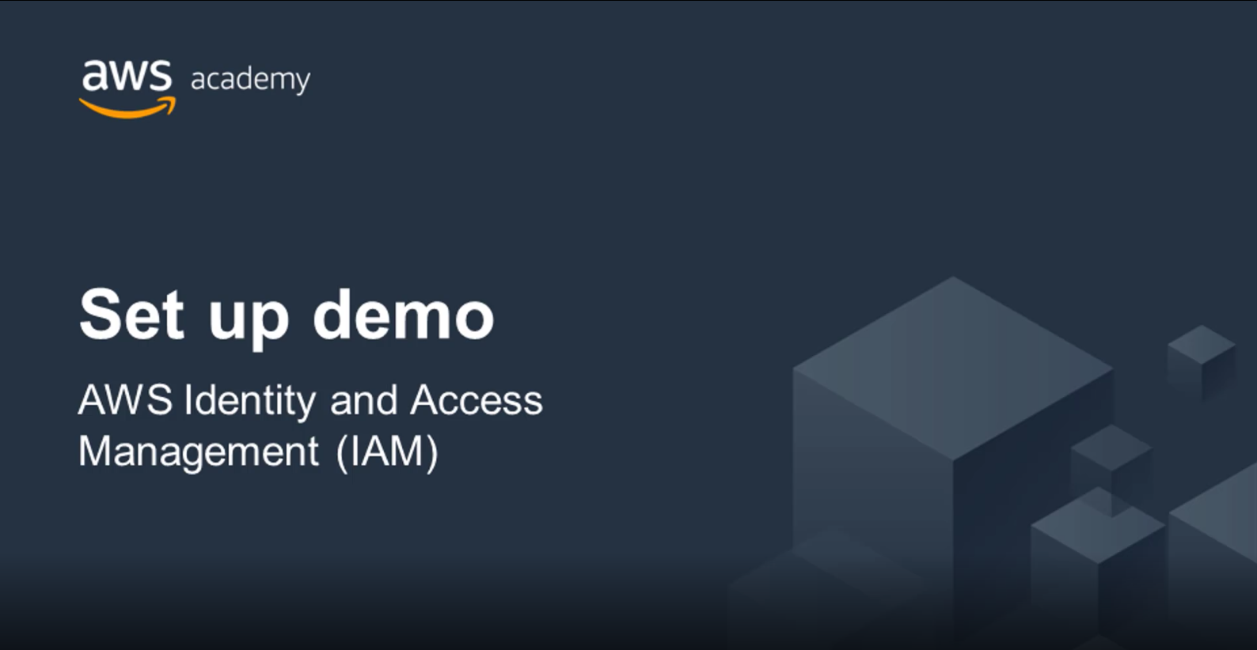
Recorded demo: IAM
Notes:
Now, take a moment to watch the IAM Demo at https://aws-tc-largeobjects.s3-us-west-2.amazonaws.com/ILT-TF-100-ACFNDS-20-EN/Module_4_IAM+v2.0.mp4. The recording runs a little over 4 minutes, and it reinforces many of the concepts that were discussed in this section of the module.
The demonstration shows how to configure the following resources by using the AWS Management Console:
An IAM role that will be used by an EC2 instance
An IAM group
An IAM user

Slide 32
Section 3: Securing a new AWS account
Module 4: AWS Cloud Security
Notes:
Introducing Section 3: Securing a new AWS account.

Slide 33

AWS account root user access versus IAM access
Account root user
IAM
Best practice: Do not use the AWS account root user except when necessary.
Access to the account root user requires logging in with the email address (and password) that you used to create the account.
Example actions that can only be done with the account root user:
Update the account root user password
Change the AWS Support plan
Restore an IAM user's permissions
Change account settings (for example, contact information, allowed Regions)
Integrates with other AWS services
Identity federation
Privileges cannot be controlled
Secure access for applications
Full access to all resources
Granular permissions
Notes:
When you first create an AWS account, you begin with a single sign-in identity that has complete access to all AWS services and resources in the account. This identity is called the AWS account root user and it is accessed by signing into the AWS Management Console with the email address and password that you used to create the account. AWS account root users have (and retain) full access to all resources in the account. Therefore, AWS strongly recommends that you do not use account root user credentials for day-to-day interactions with the account.
Instead, AWS recommends that you use IAM to create additional users and assign permissions to these users, following the principle of least privilege. For example, if you require administrator-level permissions, you can create an IAM user, grant that user full access, and then use those credentials to interact with the account. Later, if you need to revoke or modify your permissions, you can delete or modify any policies that are associated with that IAM user.
Additionally, if you have multiple users that require access to the account, you can create unique credentials for each user and define which user will have access to which resources. For example, you can create IAM users with read-only access to resources in your AWS account and distribute those credentials to users that require read access. You should avoid sharing the same credentials with multiple users.
While the account root user should not be used for routine tasks, there are a few tasks that can only be accomplished by logging in as the account root user. A full list of these tasks is detailed on the Tasks that require root user credentials AWS documentation page at https://docs.aws.amazon.com/general/latest/gr/root-vs-iam.html#aws_tasks-that-require-root.

Slide 34
Securing a new AWS account: Account root user
Step 1: Stop using the account root user as soon as possible.
The account root user has unrestricted access to all your resources.
To stop using the account root user:
While you are logged in as the account root user, create an IAM user for yourself. Save the access keys if needed.
Create an IAM group, give it full administrator permissions, and add the IAM user to the group.
Disable and remove your account root user access keys, if they exist.
Enable a password policy for users.
Sign in with your new IAM user credentials.
Store your account root user credentials in a secure place.
Notes:
To stop using the account root user, take the following steps:
While you are logged into the account root user, create an IAM user for yourself with AWS Management Console access enabled (but do not attach any permissions to the user yet). Save the IAM user access keys if needed.
Next, create an IAM group, give it a name (such as FullAccess), and attach IAM policies to the group that grant full access to at least a few of the services you will use. Next, add the IAM user to the group.
Disable and remove your account root user access keys, if they exist.
Enable a password policy for all users. Copy the IAM users sign-in link from the IAM Dashboard page. Then, sign out as the account root user.
Browse to the IAM users sign-in link that you copied, and sign in to the account by using your new IAM user credentials.
Store your account root user credentials in a secure place.
To view detailed instructions for how to set up your first IAM user and IAM group, see Creating Your First IAM Admin User and Group at https://docs.aws.amazon.com/IAM/latest/UserGuide/getting-started_create-admin-group.html.

Slide 35
Securing a new AWS account: MFA
Step 2: Enable multi-factor authentication (MFA).
Require MFA for your account root user and for all IAM users.
You can also use MFA to control access to AWS service APIs.
Options for retrieving the MFA token –
Virtual MFA-compliant applications:
Google Authenticator.
Authy Authenticator (Windows phone app).
U2F security key devices:
For example, YubiKey.
Hardware MFA options:
Key fob or display card offered by Gemalto.
MFA token
Notes:
Another recommended step for securing a new AWS account is to require multi-factor authentication (MFA) for the account root user login and for all other IAM user logins. You can also use MFA to control programmatic access. For details, see Configuring MFA-Protected API Access at https://docs.aws.amazon.com/IAM/latest/UserGuide/id_credentials_mfa_configure-api-require.html.
You have a few options for retrieving the MFA token that is needed to log in when MFA is enabled. Options include virtual MFA-compliant applications (such as Google Authenticator and Authy Authenticator), U2F security key devices, and hardware MFA options that provide a key fob or display card.

Slide 36
Securing a new AWS account: AWS CloudTrail
Step 3: Use AWS CloudTrail.
CloudTrail tracks user activity on your account.
Logs all API requests to resources in all supported services your account.
Basic AWS CloudTrail event history is enabled by default and is free.
It contains all management event data on latest 90 days of account activity.
To access CloudTrail –
Log in to the AWS Management Console and choose the CloudTrail service.
Click Event history to view, filter, and search the last 90 days of events.
To enable logs beyond 90 days and enable specified event alerting, create a trail.
From the CloudTrail Console trails page, click Create trail.
Give it a name, apply it to all Regions, and create a new Amazon S3 bucket for log storage.
Configure access restrictions on the S3 bucket (for example, only admin users should have access).
Notes:
AWS CloudTrail is a service that logs all API requests to resources in your account. In this way, it enables operational auditing on your account.
AWS CloudTrail is enabled on account creation by default on all AWS accounts, and it keeps a record of the last 90 days of account management event activity. You can view and download the last 90 days of your account activity for create, modify, and delete operations of services that are supported by CloudTrail without needing to manually create another trail. See more on the supported services at https://docs.aws.amazon.com/awscloudtrail/latest/userguide/cloudtrail-aws-service-specific-topics.html.
To enable CloudTrail log retention beyond the last 90 days and to enable alerting whenever specified events occur, create a new trail (which is described at a high level on the slide). For detailed step-by-step instructions about how to create a trail in AWS CloudTrail, see creating a trail in the AWS documentation at https://docs.aws.amazon.com/awscloudtrail/latest/userguide/cloudtrail-create-a-trail-using-the-console-first-time.html.

Slide 37
Securing a new AWS account: Billing reports
Step 4: Enable a billing report, such as the AWS Cost and Usage Report.
Billing reports provide information about your use of AWS resources and estimated costs for that use.
AWS delivers the reports to an Amazon S3 bucket that you specify.
Report is updated at least once per day.
The AWS Cost and Usage Report tracks your AWS usage and provides estimated charges associated with your AWS account, either by the hour or by the day.
Notes:
An additional recommended step for securing a new AWS account is to enable billing reports, such as the AWS Cost and Usage Report. Billing reports provide information about your use of AWS resources and estimated costs for that use. AWS delivers the reports to an Amazon S3 bucket that you specify and AWS updates the reports at least once per day.
The AWS Cost and Usage Report tracks usage in the AWS account and provides estimated charges, either by the hour or by the day.
For details about how to create an AWS Cost and Usage Report, see the AWS Documentation at https://docs.aws.amazon.com/cur/latest/userguide/cur-create.html.

Slide 38
Optional: Securing a new AWS account – Full walkthrough
Module 4: AWS Cloud Security
Notes:
The educator might optionally choose to show a full walkthrough of the first two major steps that you must complete to secure a new AWS account. (These steps were described in the previous slides.) The slides in this section provide screen captures of what it looks like to go through the process in detail.

Slide 39
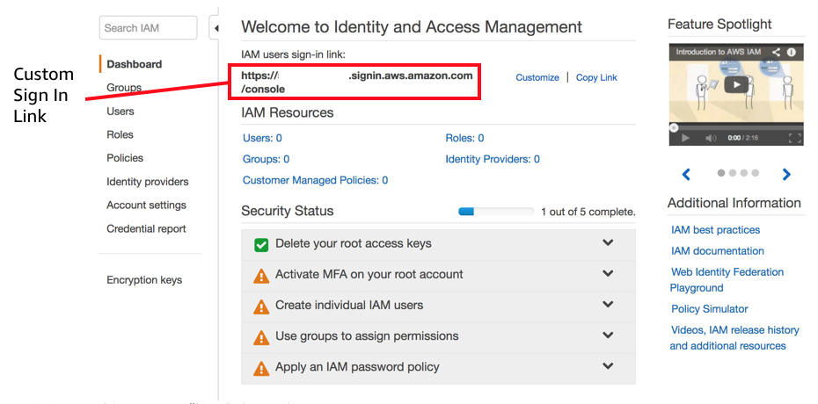
IAM security status review
Notes:
The screen capture shows an example of what the IAM Console Dashboard looks like when you are logged in as the AWS account root user. To access this screen in an account:
Log in to the AWS Management Console as the AWS account root user.
Go to the IAM service page and click the Dashboard link.
Review the information in the Security Status panel.
In the screen capture, only one of the five security status checks has been completed (Delete your root access keys). The goal of a person who completes the steps to secure the account is to receive green checks next to each security status item.
A review of the current Security Status list indicates that:
MFA has not been activated on the AWS account root user.
No individual IAM users have been created.
No permissions have been assigned to groups.
No IAM password policy has been applied.
There is a custom IAM user sign-in link for the account. Note that the account number was hidden in this screen capture. Optionally, you can use the Customize link to the right of the IAM user sign-in link to change the name of the account so that it does not display the account number. This link is used to sign in to the account, and it can be sent to users after their accounts are created.

Slide 40
Activate MFA on the account root user
Custom sign-in link
MFA activation
Notes:
Before you create IAM users in the account, activate MFA on the account root user. To log in as the account root user, use the email address that you used to create the account. The account root user has access to everything, which is why it is important to secure this account with restrictions.
To configure MFA:
Click the Activate MFA on your root account link.
Click Manage MFA.
Click Assign MFA device. You have three options: Virtual MFA device, U2F security key, and Other hardware MFA device. A hardware device is an actual hardware device.
For purposes of this demonstration, select Virtual MFA device and then click Continue.
A new dialog box appears and asks you to configure a virtual MFA device. An app (such as Google Authenticator) must be downloaded for this task. After the download is complete, click Show QR code.

Slide 41
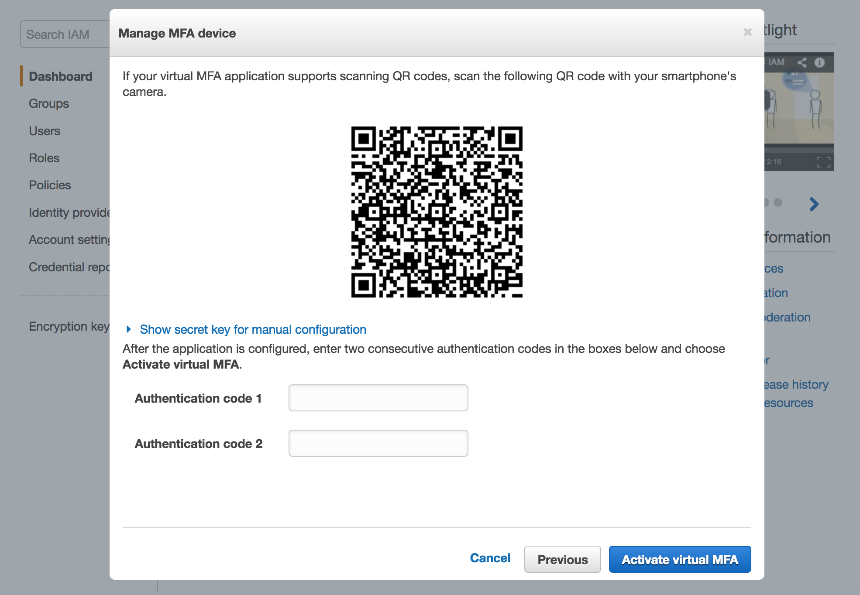
Activate MFA on account root user
Notes:
In the authenticator application, choose the plus sign (+).
Scan the barcode, and enter the first authentication code.
Wait a moment for the second code to display, and enter the second code.
Click the Assign MFA button.

Slide 42
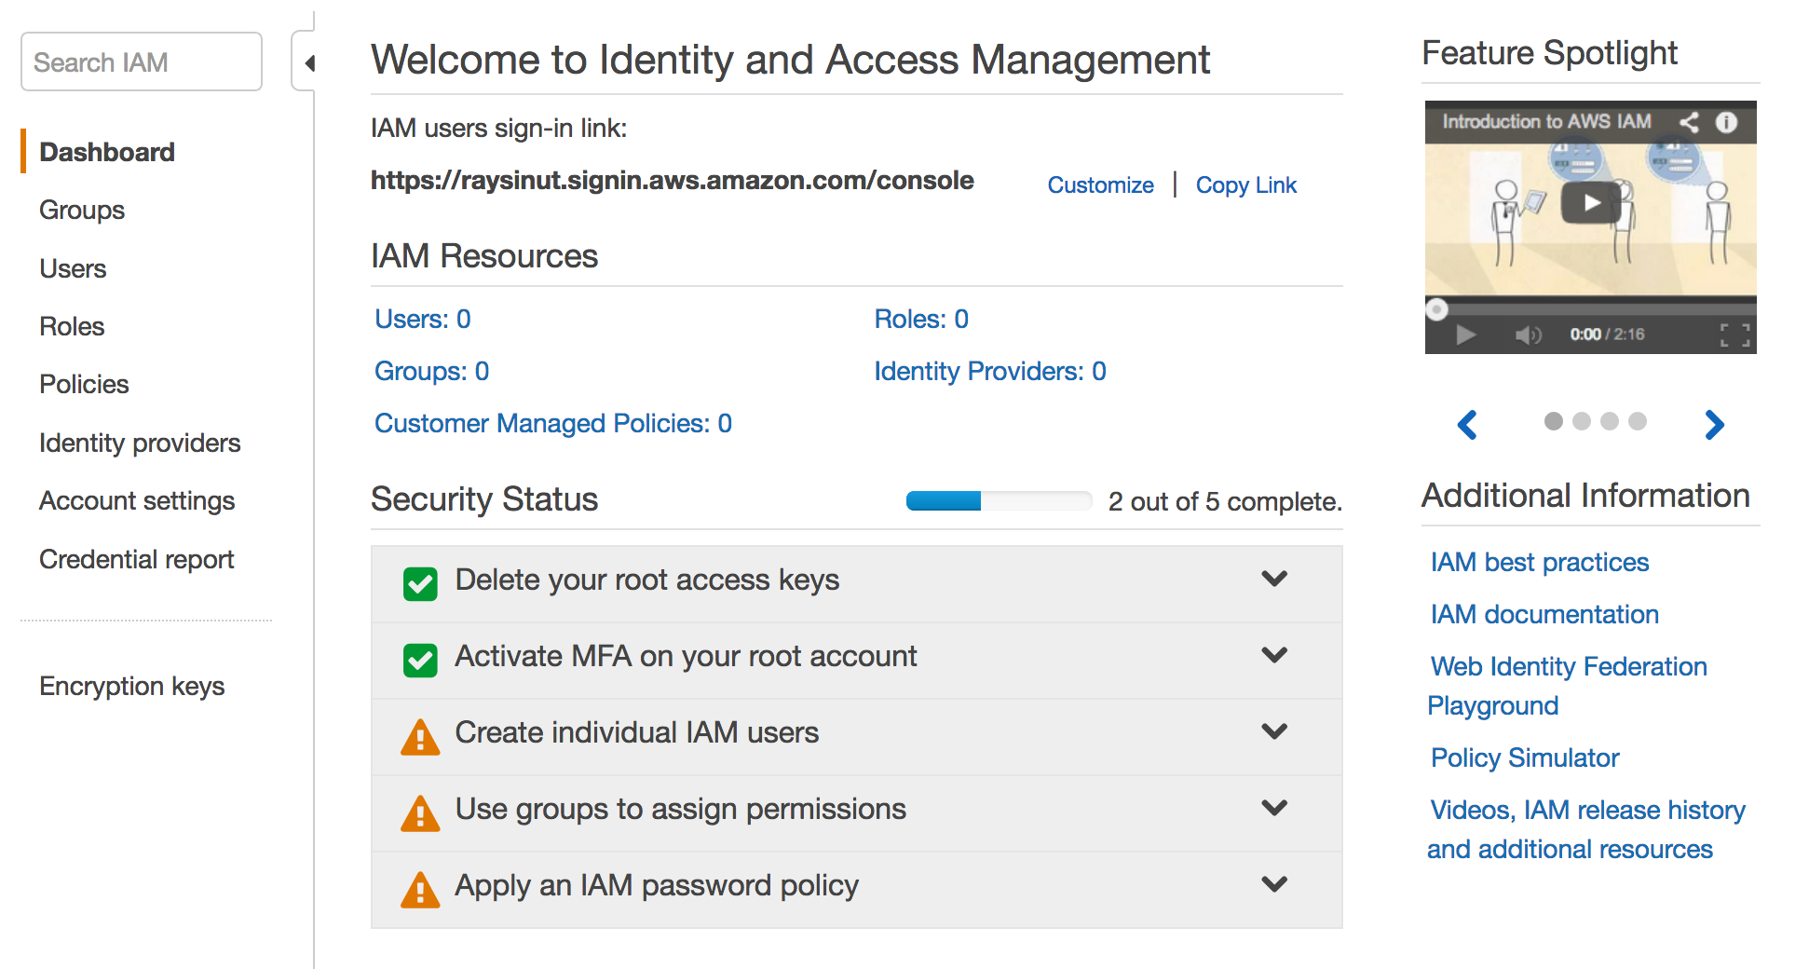
MFA on account root user is activated
MFA activated
MFA Setup
Notes:
Click Finish and refresh your browser.
In the Security Status panel, it should now show a green checkmark icon, which indicates that MFA is now activated on the account root user.

Slide 43
Create an individual IAM user (1 of 5)
IAM user creation
Notes:
Most AWS accounts are shared by multiple users in an organization. To support this practice, you can set up each user with individually assigned permissions, or you can add users to the appropriate IAM group that grants them specific permissions.
An AWS best practice is to provide each user with their own IAM user login so that they do not log in as the account root user with global privileges, or use the same credentials as someone else to log in to the account.
To configure this setup:
Click Create individual IAM users and then select Manage Users.

Slide 44
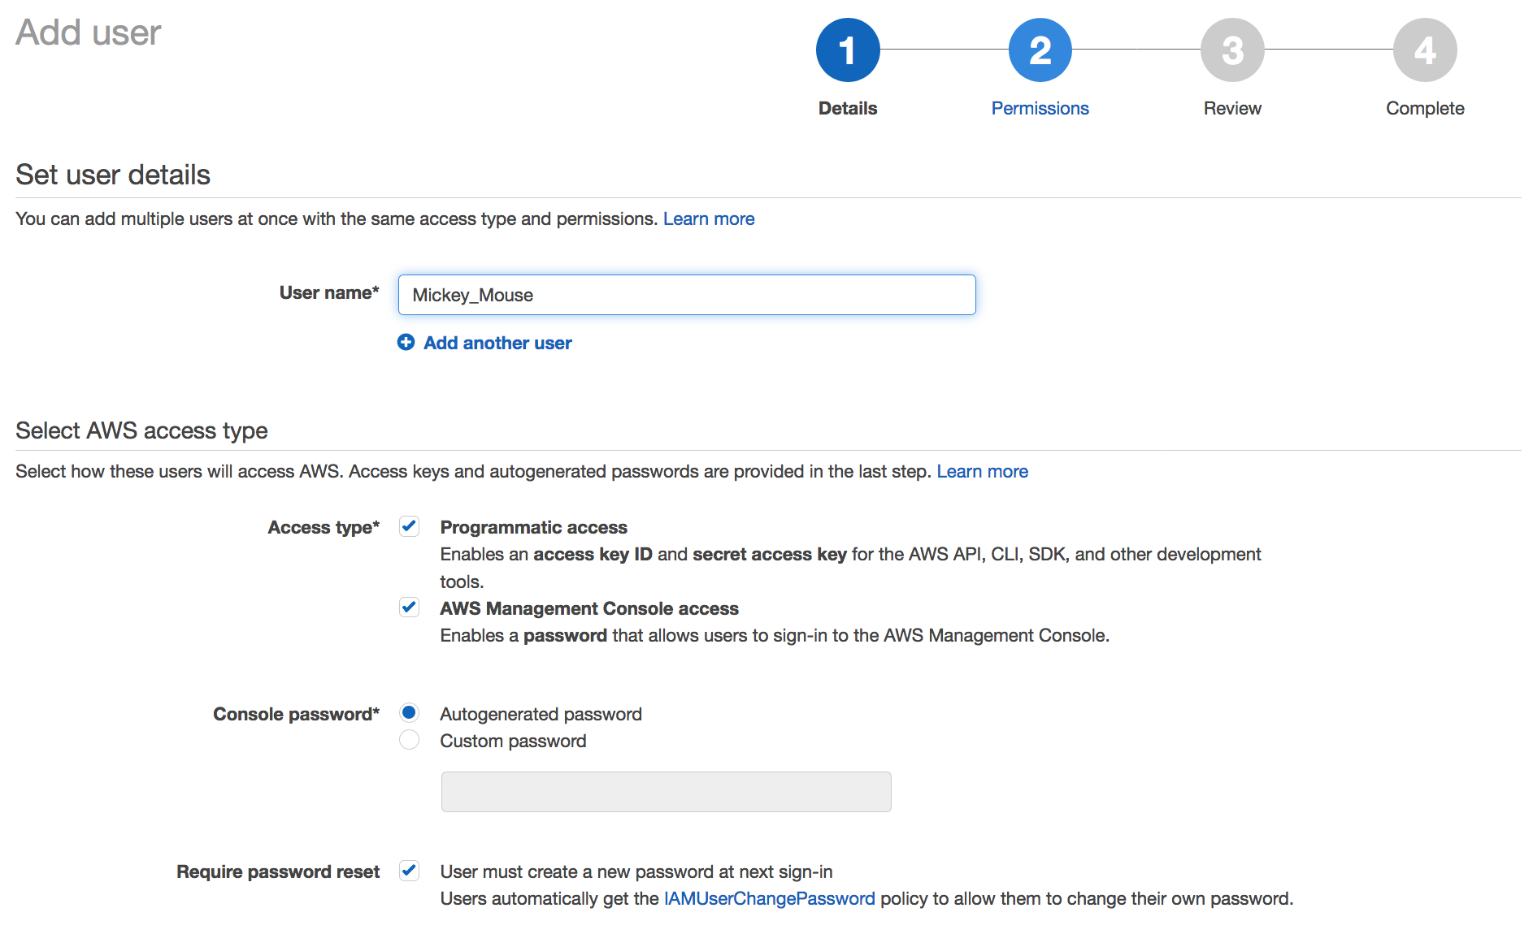
Create an individual IAM user (2 of 5)
Notes:
Select Add user and specify a new user name. Note that user names cannot have spaces.
Select the Access type. There are two access types (you can grant either type or both types to the user, but for the purposes of this demonstration, grant both types):
Programmatic access enables the user to have AWS CLI access to provision resources. This option will generate an access key one time. This access key must be saved because it will be used for all future access.
AWS Management Console access enables the user to log in to the console.
If you chose to grant console access, either choose Autogenerate password, or select Custom password and enter one.
Click Next: Permissions.

Slide 45
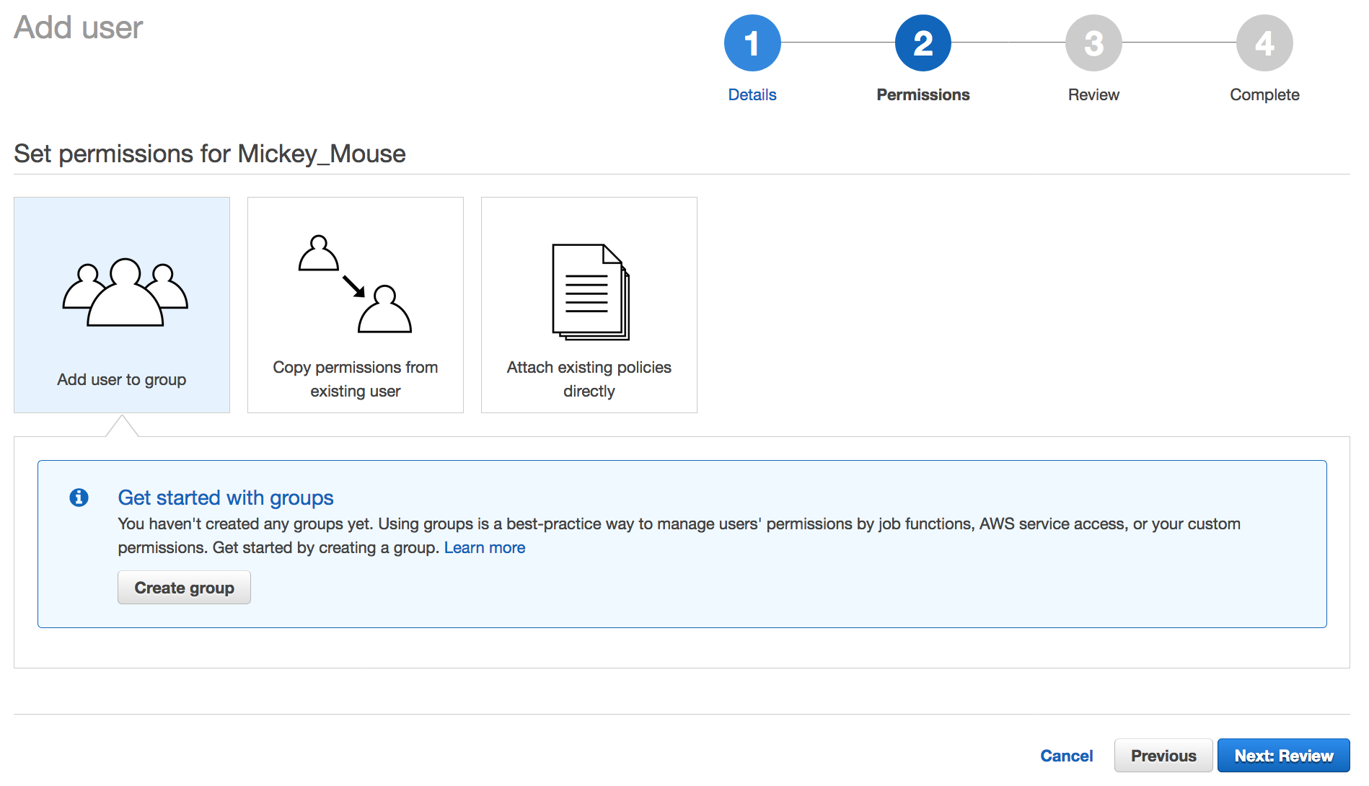
Create an individual IAM user (3 of 5)
Notes:
Next, you will assign permissions. You have three options for assigning permissions:
Add user to group
Copy permissions from an existing user
Attach existing policies directly
You want to add the user to a group, so select Add user to group and then choose Create group.
Note: A group is where you put users to inherit the policies that are assigned to the group.

Slide 46
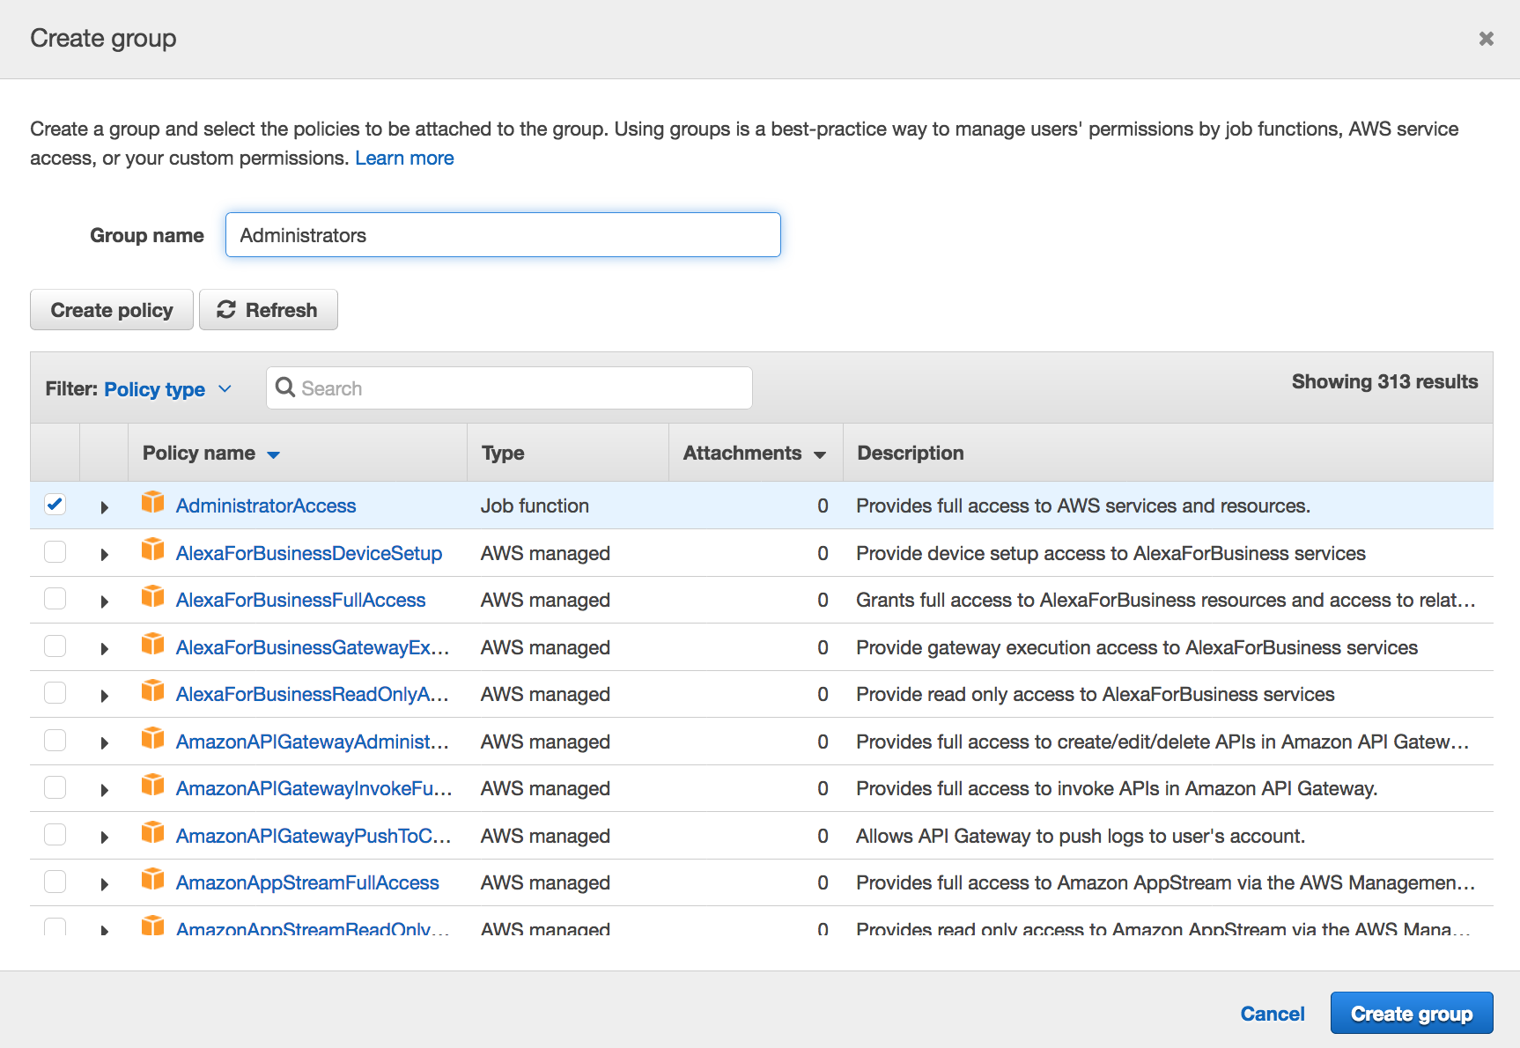
Create an individual IAM user (4 of 5)
Notes:
Give the group a name. In this example, give the lead developer administrative access and then choose Create group.
For accessibility: The user is prompted to create a group. The group name "Administrators" has been typed in and a policy named "AdministratorAccess" has been selected from a long list of available policies. End of accessibility description.

Slide 47
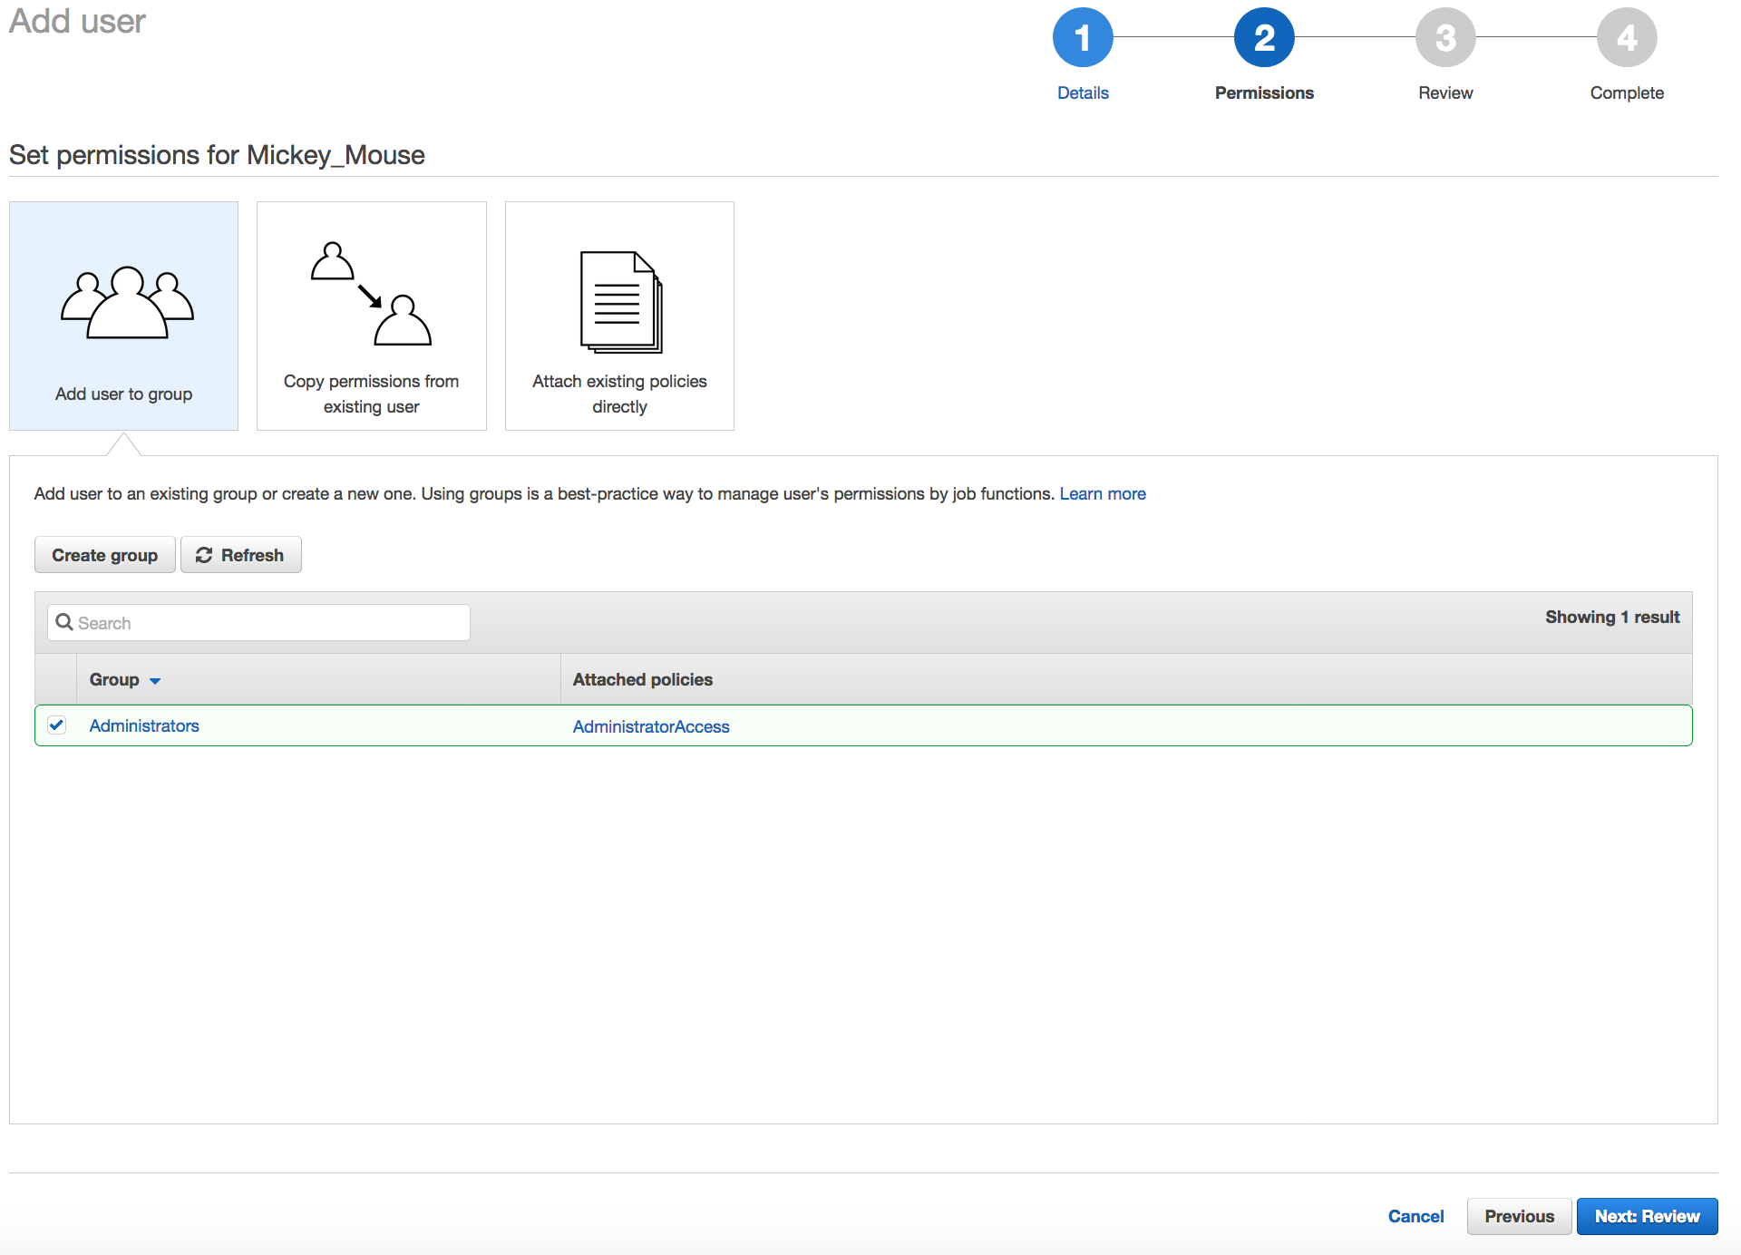
Create an individual IAM user (5 of 5)
Notes:
Select Next Review to review what will be created, and then choose Create user.

Slide 48
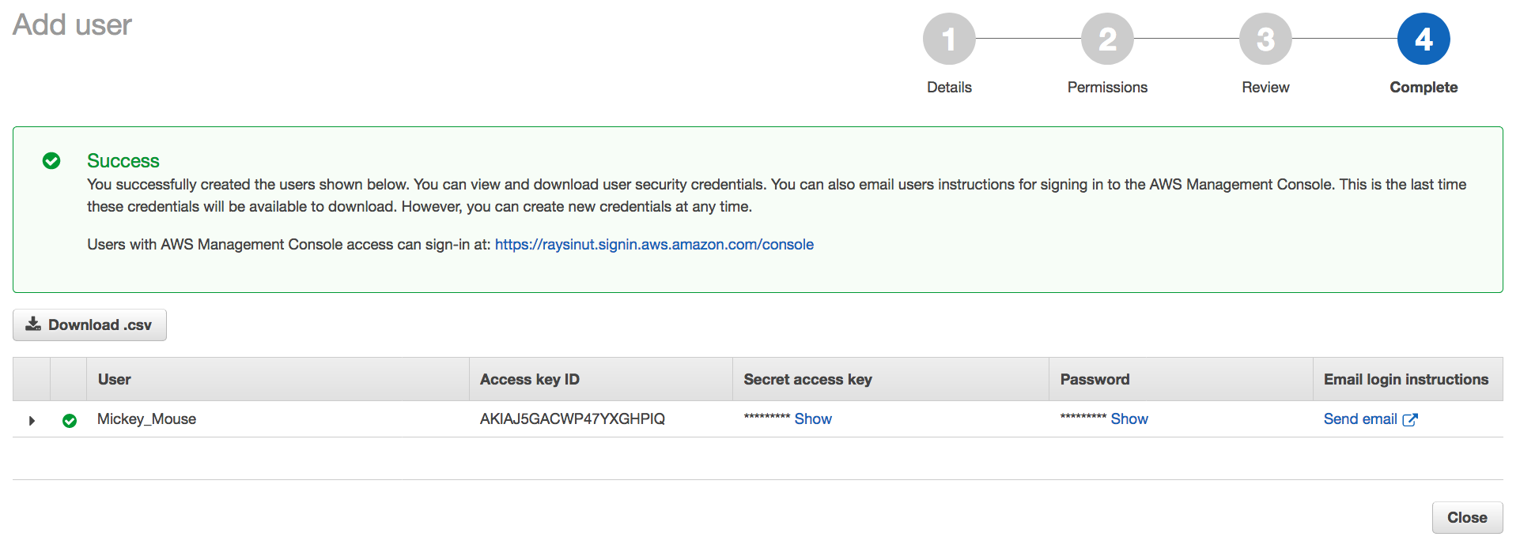
IAM user creation successful
Notes:
When a user is created—and assuming you enabled both programmatic and console access when you defined the Access type setting and created the user—several artifacts will be generated:
An access key ID that can be used to sign AWS API calls when the user uses the AWS CLI or AWS SDKs.
A secret access key that is also used to sign AWS API calls when the user uses the AWS CLI or AWS SDKs.
A password that can be used to log in to the AWS Management Console.
Choose Show to display the values in each field. The credentials can also be downloaded by choosing Download .csv. This time is the only time when you have the option to download these credentials. You will not have an opportunity to retrieve the secret access key after this screen. Thus, you should either download the credentials, or—at the minimum—copy the secret access key, and paste it in a safe location.
Important: Never store these credentials in a public place (for example, never embed these credentials in code that you upload to GitHub or elsewhere). This information can be used to access your account. If you ever have a concern that your credentials have been compromised, log in as a user with IAM administrator access permissions and delete the existing access key. You can then optionally create a new access key.

Slide 49
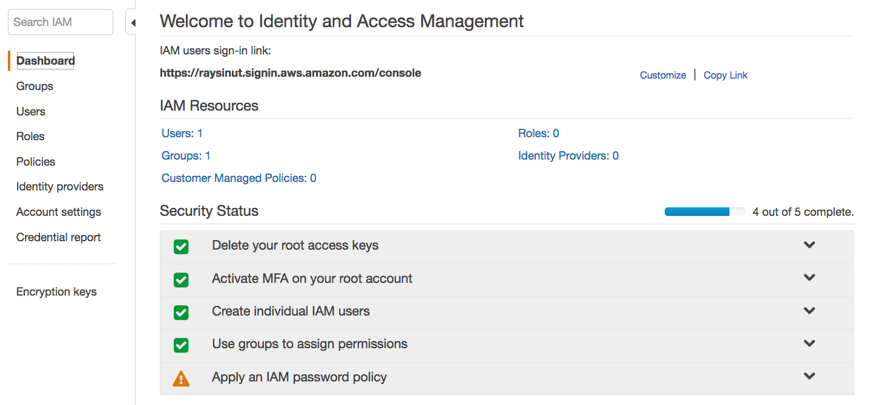
IAM Dashboard security status
Password policy creation
Notes:
When you return to the IAM Dashboard, the Create individual IAM users and Use groups to assign permissions security status items should show that they were addressed.
The remaining security item to address is to apply an IAM password policy.

Slide 50
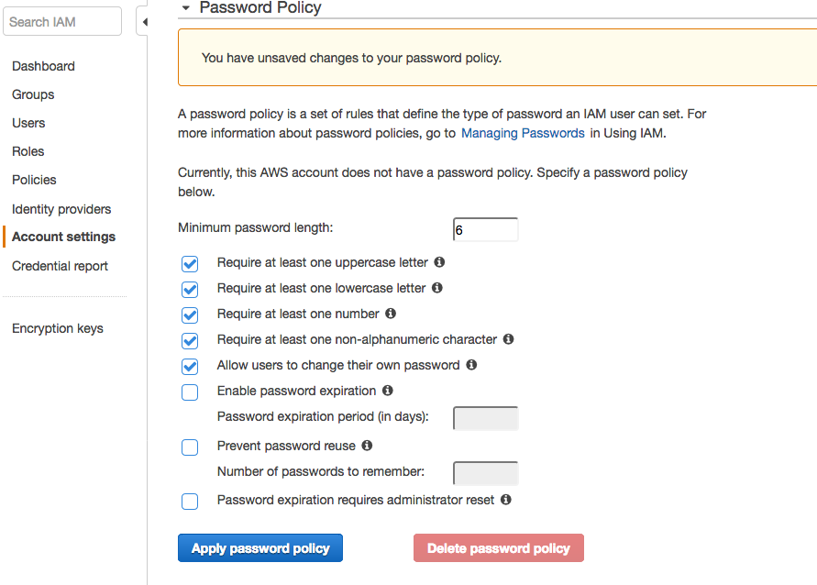
Set an IAM password policy
Notes:
The IAM password policy is a set of rules that defines the type of password that an IAM user can set.
Select the rules that the passwords should comply with and then choose Apply password policy.
For accessibility: The screen in the console where you can set password policy details. There are multiple checkboxes available to require stronger password requirements. End of accessibility description.

Slide 51
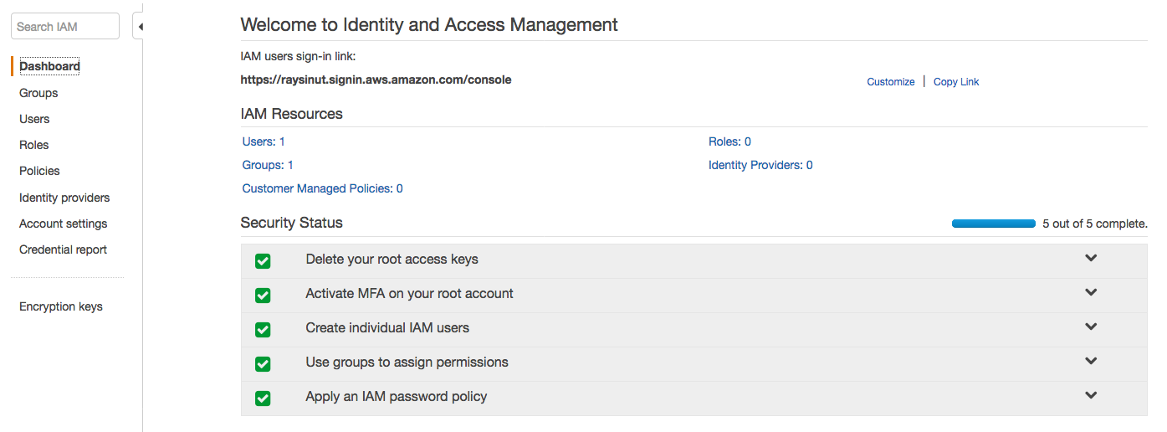
Security status checks completed
Notes:
All the security status checkmarks should now be green. Your account is now in compliance with the listed IAM security status checks. Congratulations!

Slide 52
Section 3 key takeaways
Best practices to secure an AWS account:
Secure logins with multi-factor authentication (MFA).
Delete account root user access keys.
Create individual IAM users and grant permissions according to the principle of least privilege.
Use groups to assign permissions to IAM users.
Configure a strong password policy.
Delegate using roles instead of sharing credentials.
Monitor account activity by using AWS CloudTrail.
Notes:
The key takeaways from this section of the module are all related to best practices for securing an AWS account. Those best practice recommendations include:
Secure logins with multi-factor authentication (MFA).
Delete account root user access keys.
Create individual IAM users and grant permissions according to the principle of least privilege.
Use groups to assign permissions to IAM users.
Configure a strong password policy.
Delegate using roles instead of sharing credentials.
Monitor account activity using AWS CloudTrail.

Slide 53

Lab 1: Introduction to IAM
Notes:
Introducing Lab 1: Introduction to AWS IAM.

Slide 54
Lab 1: Tasks
Task 1: Explore the Users and Groups.
Task 2: Add Users to Groups.
Task 3: Sign-In and Test Users.
AWS Identity and Access Management (IAM)
Notes:
In this hands-on lab, you will:
Explore pre-created IAM users and groups.
Inspect IAM policies as they are applied to the pre-created groups.
Follow a real-world scenario and add users to groups that have specific capabilities enabled.
Locate and use the IAM sign-in URL.
Experiment with the effects of IAM policies on access to AWS resources.

Slide 55
Lab 1: Final product
Account
AWS account
Users
Groups
user-1
user-2
user-3
EC2-Admin
EC2-Support
S3-Support
user-2
Amazon EC2 read-only access
Amazon EC2 – View, start, and stop access
IAM inline policy
IAM managed policy S3 read-only access
user-3
user-1
Notes:
The diagram shows the resources that your AWS account will have after you complete the lab steps. It also describes how the resources will be configured.

Slide 56


Begin Lab 1: Introduction to AWS IAM
~ 40 minutes
Notes:
It is now time to start the lab.

Slide 57
Lab debrief: Key takeaways
Notes:
The instructor will now lead a conversation about the key takeaways from the lab after you complete it.

Slide 58
Section 4: Securing accounts
Module 4: AWS Cloud Security
Notes:
Introducing Section 4: Securing accounts

Slide 59

AWS Organizations
AWS Organizations enables you to consolidate multiple AWS accounts so that you centrally manage them.
Security features of AWS Organizations:
Group AWS accounts into organizational units (OUs) and attach different access policies to each OU.
Integration and support for IAM
Permissions to a user are the intersection of what is allowed by AWS Organizations and what is granted by IAM in that account.
Use service control policies to establish control over the AWS services and API actions that each AWS account can access
AWS Organizations
Notes:
AWS Organizations is an account management service that enables you to consolidate multiple AWS accounts into an organization that you create and centrally manage. Here, the focus is on the security features that AWS Organizations provides.
One helpful security feature is that you can group accounts into organizational units (OUs) and attach different access policies to each OU. For example, if you have accounts that should only be allowed to access AWS services that meet certain regulatory requirements, you can put those accounts into one OU. You then can define a policy that blocks OU access to services that do not meet those regulatory requirements, and then attach the policy to the OU.
Another security feature is that AWS Organizations integrates with and supports IAM. AWS Organizations expands that control to the account level by giving you control over what users and roles in an account or a group of accounts can do. The resulting permissions are the logical intersection of what is allowed by the AWS Organizations policy settings and what permissions are explicitly granted by IAM in the account for that user or role. The user can access only what is allowed by both the AWS Organizations policies and IAM policies.
Finally, AWS Organizations provides service control policies (SCPs) that enable you to specify the maximum permissions that member accounts in the organization can have. In SCPs, you can restrict which AWS services, resources, and individual actions the users and roles in each member account can access. These restrictions even override the administrators of member accounts. When AWS Organizations blocks access to a service, resource, or API action, a user or role in that account can't access it, even if an administrator of a member account explicitly grants such permissions.

Slide 60
AWS Organizations: Service control policies
Service control policies (SCPs) offer centralized control over accounts.
Limit permissions that are available in an account that is part of an organization.
Ensures that accounts comply with access control guidelines.
SCPs are similar to IAM permissions policies –
They use similar syntax.
However, an SCP never grants permissions.
Instead, SCPs specify the maximum permissions for an organization.
Notes:
Here is a closer look at the Service control policies (SCPs) feature of AWS Organizations.
SCPs offer central control over the maximum available permissions for all accounts in your organization, enabling you to ensure that your accounts stay in your organization’s access control guidelines. SCPs are available only in an organization that has all features enabled, including consolidated billing. See more on enabling features at https://docs.aws.amazon.com/organizations/latest/userguide/orgs_manage_org_support-all-features.html. SCPs aren't available if your organization has enabled only the consolidated billing features. For instructions about enabling SCPs, see Enabling and Disabling a Policy Type on a Root at https://docs.aws.amazon.com/organizations/latest/userguide/orgs_manage_policies.html#enable_policies_on_root.
SCPs are similar to IAM permissions policies and they use almost the same syntax. However, an SCP never grants permissions. Instead, SCPs are JSON policies that specify the maximum permissions for an organization or OU. Attaching an SCP to the organization root or an organizational unit (OU) defines a safeguard for the actions that accounts in the organization root or OU can do. However, it is not a substitute for well-managed IAM configurations within each account. You must still attach IAM policies to users and roles in your organization's accounts to actually grant permissions to them. See more on IAM policies at https://docs.aws.amazon.com/IAM/latest/UserGuide/access_policies.html.

Slide 61

AWS Key Management Service (AWS KMS)
AWS Key Management Service (AWS KMS) features:
Enables you to create and manage encryption keys
Enables you to control the use of encryption across AWS services and in your applications.
Integrates with AWS CloudTrail to log all key usage.
Uses hardware security modules (HSMs) that are validated by Federal Information Processing Standards (FIPS) 140-2 to protect keys
AWS Key Management Service (AWS KMS)
Notes:
AWS Key Management Service (AWS KMS) is a service that enables you to create and manage encryption keys, and to control the use of encryption across a wide range of AWS services and your applications. AWS KMS is a secure and resilient service that uses hardware security modules (HSMs) that were validated under Federal Information Processing Standards (FIPS) 140-2 (or are in the process of being validated) to protect your keys. AWS KMS also integrates with AWS CloudTrail to provide you with logs of all key usage to help meet your regulatory and compliance needs.
Customer master keys (CMKs) are used to control access to data encryption keys that encrypt and decrypt your data. You can create new keys when you want, and you can manage who has access to these keys and who can use them. You can also import keys from your own key management infrastructure into AWS KMS.
AWS KMS integrates with most AWS services, which means that you can use AWS KMS CMKs to control the encryption of the data that you store in these services. To learn more, see AWS Key Management Service features at https://aws.amazon.com/kms/features/.

Slide 62

Amazon Cognito
Amazon Cognito features:
Adds user sign-up, sign-in, and access control to your web and mobile applications.
Scales to millions of users.
Supports sign-in with social identity providers, such as Facebook, Google, and Amazon; and enterprise identity providers, such as Microsoft Active Directory via Security Assertion Markup Language (SAML) 2.0.
Amazon Cognito
Notes:
Amazon Cognito provides solutions to control access to AWS resources from your application. You can define roles and map users to different roles so your application can access only the resources that are authorized for each user.
Amazon Cognito uses common identity management standards, such as Security Assertion Markup Language (SAML) 2.0. SAML is an open standard for exchanging identity and security information with applications and service providers. Applications and service providers that support SAML enable you to sign in by using your corporate directory credentials, such as your username and password from Microsoft Active Directory. With SAML, you can use single sign-on (SSO) to sign in to all of your SAML-enabled applications by using a single set of credentials.
Amazon Cognito helps you meet multiple security and compliance requirements, including requirements for highly regulated organizations such as healthcare companies and merchants. Amazon Cognito is eligible for use with the US Health Insurance Portability and Accountability Act (HIPAA – see more on HIPAA at https://aws.amazon.com/compliance/hipaa-compliance/). It can also be used for workloads that are compliant with the Payment Card Industry Data Security Standard (PCI DSS – more on PCI DSS at https://aws.amazon.com/compliance/pci-dss-level-1-faqs/); the American Institute of CPAs (AICPA) Service Organization Control (SOC – more on SOC at https://aws.amazon.com/compliance/soc-faqs/); the International Organization for Standardization (ISO) and International Electrotechnical Commission (IEC) standards. More on ISO/IEC 27001 at https://aws.amazon.com/compliance/iso-27001-faqs/, ISO/IEC 27017 at https://aws.amazon.com/compliance/iso-27017-faqs/, and ISO/IEC 27018 at https://aws.amazon.com/compliance/iso-27018-faqs/; and ISO 9001 at https://aws.amazon.com/compliance/iso-9001-faqs/.

Slide 63
AWS Shield
AWS Shield features:
Is a managed distributed denial of service (DDoS) protection service
Safeguards applications running on AWS
Provides always-on detection and automatic inline mitigations
AWS Shield Standard enabled for at no additional cost. AWS Shield Advanced is an optional paid service.
Use it to minimize application downtime and latency.
AWS Shield
Notes:
AWS Shield is a managed distributed denial of service (DDoS) protection service that safeguards applications that run on AWS. It provides always-on detection and automatic inline mitigations that minimize application downtime and latency, so there is no need to engage AWS Support to benefit from DDoS protection.
AWS Shield helps protects your website from all types of DDoS attacks, including Infrastructure layer attacks (like User Datagram Protocol—or UDP—floods), state exhaustion attacks (like TCP SYN floods), and application-layer attacks (like HTTP GET or POST floods). For examples, see the AWS WAF Developer Guide at https://docs.aws.amazon.com/waf/latest/developerguide/waf-chapter.html.
AWS Shield Standard is automatically enabled to all AWS customers at no additional cost.
AWS Shield Advanced is an optional paid service. AWS Shield Advanced provides additional protections against more sophisticated and larger attacks for your applications that run on Amazon EC2, Elastic Load Balancing, Amazon CloudFront, AWS Global Accelerator, and Amazon Route 53. AWS Shield Advanced is available to all customers. However, to contact the DDoS Response Team, customers need to have either Enterprise Support or Business Support from AWS Support.

Slide 64
Section 5: Securing data on AWS
Module 4: AWS Cloud Security
Notes:
Introducing Section 5: Securing data on AWS

Slide 65




Encryption of data at rest
Encryption encodes data with a secret key, which makes it unreadable
Only those who have the secret key can decode the data
AWS KMS can manage your secret keys
AWS supports encryption of data at rest
Data at rest = Data stored physically (on disk or on tape)
You can encrypt data stored in any service that is supported by AWS KMS, including:
Amazon S3
Amazon EBS
Amazon Elastic File System (Amazon EFS)
Amazon RDS managed databases
Notes:
Data encryption is an essential tool to use when your objective is to protect digital data. Data encryption takes data that is legible and encodes it so that it is unreadable to anyone who does not have access to the secret key that can be used to decode it. Thus, even if an attacker gains access to your data, they cannot make sense of it.
Data at rest refers to data that is physically stored on disk or on tape.
You can create encrypted file systems on AWS so that all your data and metadata is encrypted at rest by using the open standard Advanced Encryption Standard (AES)-256 encryption algorithm. When you use AWS KMS, encryption and decryption are handled automatically and transparently, so that you do not need to modify your applications. If your organization is subject to corporate or regulatory policies that require encryption of data and metadata at rest, AWS recommends enabling encryption on all services that store your data. You can encrypt data stored in any service that is supported by AWS KMS. See How AWS Services use AWS KMS for a list of supported services at https://docs.aws.amazon.com/kms/latest/developerguide/service-integration.html.

Slide 66





Encryption of data in transit
Encryption of data in transit (data moving across a network)
Transport Layer Security (TLS)—formerly SSL—is an open standard protocol
AWS Certificate Manager provides a way to manage, deploy, and renew TLS or SSL certificates
Secure HTTP (HTTPS) creates a secure tunnel
Uses TLS or SSL for the bidirectional exchange of data
AWS services support data in transit encryption.
Two examples:
AWS Cloud
Corporate data center
AWS Cloud
TLS encrypted data traffic
TLS or SSL
encrypted
Amazon EC2
Amazon EFS
AWS Storage Gateway
Amazon S3
Notes:
Data in transit refers to data that is moving across the network. Encryption of data in transit is accomplished by using Transport Layer Security (TLS) 1.2 with an open standard AES-256 cipher. TLS was formerly called Secure Sockets Layer (SSL).
AWS Certificate Manager is a service that enables you to provision, manage, and deploy SSL or TLS certificates for use with AWS services and your internal connected resources. SSL or TLS certificates are used to secure network communications and establish the identity of websites over the internet, and also resources on private networks. With AWS Certificate Manager, you can request a certificate and then deploy it on AWS resources (such as load balancers or CloudFront distributions). AWS Certificate Manager also handles certificate renewals.
Web traffic that runs over HTTP is not secure. However, traffic that runs over Secure HTTP (HTTPS) is encrypted by using TLS or SSL. HTTPS traffic is protected against eavesdropping and man-in-the-middle attacks because of the bidirectional encryption of the communication.
AWS services support encryption for data in transit. Two examples of encryption for data in transit are shown. The first example shows an EC2 instance that has mounted an Amazon EFS shared file system. All data traffic between the instance and Amazon EFS is encrypted by using TLS or SSL. For further details about this configuration, see Encryption of EFS Data in Transit at https://docs.aws.amazon.com/whitepapers/latest/efs-encrypted-file-systems/encryption-of-data-in-transit.html.
The second example shows the use of AWS Storage Gateway, a hybrid cloud storage service that provides on-premises access to AWS Cloud storage. In this example, the storage gateway is connected across the internet to Amazon S3, and the connection encrypts the data in transit.

Slide 67
Securing Amazon S3 buckets and objects
Newly created S3 buckets and objects are private and protected by default.
When use cases require sharing data objects on Amazon S3 –
It is essential to manage and control the data access.
Follow the permissions that follow the principle of least privilege and consider using Amazon S3 encryption.
Tools and options for controlling access to S3 data include –
Amazon S3 Block Public Access feature: Simple to use.
IAM policies: A good option when the user can authenticate using IAM.
Bucket policies
Access control lists (ACLs): A legacy access control mechanism.
AWS Trusted Advisor bucket permission check: A free feature.
Notes:
By default, all Amazon S3 buckets are private and can be accessed only by users who are explicitly granted access. It is essential to manage and control access to Amazon S3 data. AWS provides many tools and options for controlling access to your S3 buckets or objects, including:
Using Amazon S3 Block Public Access. These settings override any other policies or object permissions. Enable Block Public Access for all buckets that you don't want to be publicly accessible. This feature provides a straightforward method for avoiding unintended exposure of Amazon S3 data.
Writing IAM policies that specify the users or roles that can access specific buckets and objects. This method was discussed in detail earlier in this module.
Writing bucket policies that define access to specific buckets or objects. This option is typically used when the user or system cannot authenticate by using IAM. Bucket policies can be configured to grant access across AWS accounts or to grant public or anonymous access to Amazon S3 data. If bucket policies are used, they should be written carefully and tested fully. You can specify a deny statement in a bucket policy to restrict access. Access will be restricted even if the users have permissions that are granted in an identity-based policy that is attached to the users.
Setting access control lists (ACLs) on your buckets and objects. ACLs are less commonly used (ACLs predate IAM). If you do use ACLs, do not set access that is too open or permissive.
AWS Trusted Advisor provides a bucket permission check feature that is a useful tool for discovering if any of the buckets in your account have permissions that grant global access.

Slide 68
Section 6: Working to ensure compliance
Module 4: AWS Cloud Security
Notes:
Introducing Section 6: Working to ensure compliance.

Slide 69



AWS compliance programs
Customers are subject to many different security and compliance regulations and requirements.
AWS engages with certifying bodies and independent auditors to provide customers with detailed information about the policies, processes, and controls that are established and operated by AWS.
Compliance programs can be broadly categorized –
Certifications and attestations
Assessed by a third-party, independent auditor
Examples: ISO 27001, 27017, 27018, and ISO/IEC 9001
Laws, regulations, and privacy
AWS provides security features and legal agreements to support compliance
Examples: EU General Data Protection Regulation (GDPR), HIPAA
Alignments and frameworks
Industry- or function-specific security or compliance requirements
Examples: Center for Internet Security (CIS), EU-US Privacy Shield certified
Notes:
AWS engages with external certifying bodies and independent auditors to provide customers with information about the policies, processes, and controls that are established and operated by AWS.
A full Listing of AWS Compliance Programs is available at https://aws.amazon.com/compliance/programs/. Also, for details about which AWS services are in scope of AWS assurance programs, see AWS Services in Scope by Compliance Program at https://aws.amazon.com/compliance/services-in-scope/.
As an example of a certification for which you can use AWS services to meet your compliance goals, consider the ISO/IEC 27001:2013 certification. It specifies the requirements for establishing, implementing, maintaining, and continually improving an Information Security Management System. The basis of this certification is the development and implementation of a rigorous security program, which includes the development and implementation of an Information Security Management System. The Information Security Management System defines how AWS perpetually manages security in a holistic, comprehensive manner.
AWS also provides security features and legal agreements that are designed to help support customers with common regulations and laws. One example is the Health Insurance Portability and Accountability Act (HIPAA) regulation. Another example, the European Union (EU) General Data Protection Regulation (GDPR) protects European Union data subjects' fundamental right to privacy and the protection of personal data. It introduces robust requirements that will raise and harmonize standards for data protection, security, and compliance. The GDPR Center at https://aws.amazon.com/compliance/gdpr-center/ contains many resources to help customers meet their compliance requirements with this regulation.

Slide 70

AWS Config
Assess, audit, and evaluate the configurations of AWS resources.
Use for continuous monitoring of configurations.
Automatically evaluate recorded configurations versus desired configurations.
Review configuration changes.
View detailed configuration histories.
Simplify compliance auditing and security analysis.
AWS Config
Example AWS Config Dashboard view
Notes:
AWS Config is a service that enables you to assess, audit, and evaluate the configurations of your AWS resources. AWS Config continuously monitors and records your AWS resource configurations, and it enables you to automate the evaluation of recorded configurations against desired configurations. With AWS Config, you can review changes in configurations and relationships between AWS resources, review detailed resource configuration histories, and determine your overall compliance against the configurations that are specified in your internal guidelines. This enables you to simplify compliance auditing, security analysis, change management, and operational troubleshooting.
As you can see in the AWS Config Dashboard screen capture shown here, AWS Config keeps an inventory listing of all resources that exist in the account, and it then checks for configuration rule compliance and resource compliance. Resources that are found to be noncompliant are flagged, which alerts you to the configuration issues that should be addressed within the account.
AWS Config is a Regional service. To track resources across Regions, enable it in every Region that you use. AWS Config offers an aggregator feature that can show an aggregated view of resources across multiple Regions and even multiple accounts.

Slide 71

AWS Artifact
Is a resource for compliance-related information
Provide access to security and compliance reports, and select online agreements
Can access example downloads:
AWS ISO certifications
Payment Card Industry (PCI) and Service Organization Control (SOC) reports
Access AWS Artifact directly from the AWS Management Console
Under Security, Identify & Compliance, click Artifact.
AWS Artifact
Notes:
AWS Artifact provides on-demand downloads of AWS security and compliance documents, such as AWS ISO certifications, Payment Card Industry (PCI), and Service Organization Control (SOC) reports. You can submit the security and compliance documents (also known as audit artifacts) to your auditors or regulators to demonstrate the security and compliance of the AWS infrastructure and services that you use. You can also use these documents as guidelines to evaluate your own cloud architecture and assess the effectiveness of your company's internal controls. AWS Artifact provides documents about AWS only. AWS customers are responsible for developing or obtaining documents that demonstrate the security and compliance of their companies.
You can also use AWS Artifact to review, accept, and track the status of AWS agreements such as the Business Associate Agreement (BAA). A BAA typically is required for companies that are subject to HIPAA to ensure that protected health information (PHI) is appropriately safeguarded. With AWS Artifact, you can accept agreements with AWS and designate AWS accounts that can legally process restricted information. You can accept an agreement on behalf of multiple accounts. To accept agreements for multiple accounts, use AWS Organizations to create an organization. To learn more, see Managing agreements in AWS Artifact at https://docs.aws.amazon.com/artifact/latest/ug/managing-agreements.html.

Slide 72
Section 6 key takeaways
AWS security compliance programs provide information about the policies, processes, and controls that are established and operated by AWS.
AWS Config is used to assess, audit, and evaluate the configurations of AWS resources.
AWS Artifact provides access to security and compliance reports.
Notes:
Some key takeaways from this section of the module include:
AWS security compliance programs provide information about the policies, processes, and controls that are established and operated by AWS.
AWS Config is used to assess, audit, and evaluate the configurations of AWS resources.
AWS Artifact provides access to security and compliance reports.

Slide 73
Section 7: Additional security services and resources
Module 4: AWS Cloud Security
Notes:
Introducing Section 7: Additional security services and resources

Slide 74

AWS Service Catalog
Create and manage catalogs of IT services that are approved by your organization
Helps employees find and deploy approved IT services
An IT service can include one or more AWS resources
Example:
EC2 instances, storage volumes, databases, and networking components
Control AWS service usage by specifying constraints –
Example constraints:
The AWS Region where a product can be launched
Allowed IP address ranges
Centrally manage the IT service lifecycle
Help meet compliance requirements
AWS Service Catalog
Notes:
AWS Service Catalog enables organizations to create and manage catalogs of IT services that are approved for use (for example, for your employees to use) on AWS. These IT services can include everything from virtual machine images, servers, software, and databases to complete multi-tier application architectures.
From the perspective of AWS Service Catalog, an IT service can be thought of as a product. A product could be a single compute instance that runs Amazon Linux, it could be a fully configured multi-tier web application that runs in its own environment, or it could be any other useful IT service that you build on AWS. This enables your users to quickly deploy the IT services that they need, and it is designed so that users deploy only approved configurations. AWS Service Catalog can support your efforts to centrally manage deployed IT services, and it can help you achieve consistent governance and meet compliance requirements.
For more information, see AWS Service Catalog in the AWS documentation at https://aws.amazon.com/servicecatalog/?aws-service-catalog.sort-by=item.additionalFields.createdDate&aws-service-catalog.sort-order=desc.

Slide 75



Selected additional security services
Proactively protect personally identifiable information (PII) and know when it moves.
Amazon Macie
Define standards and best practices for your applications and validate adherence to these standards.
Amazon Inspector
Intelligent threat detection and continuous monitoring to protect your AWS accounts and workloads.
Amazon GuardDuty
Notes:
Amazon Macie is a security service that uses machine learning to automatically discover, classify, and protect sensitive data in AWS. Amazon Macie recognizes sensitive data such as personally identifiable information (PII) or intellectual property. It provides you with dashboards and alerts that give visibility into how this data is being accessed or moved. Amazon Macie is a fully managed service that continuously monitors data access activity for anomalies, and it generates detailed alerts when it detects risk of unauthorized access or inadvertent data leaks. Amazon Macie is currently available to protect data that is stored in Amazon S3.
Amazon Inspector is an automated security assessment service that helps improve the security and compliance of applications that are deployed on AWS. Amazon Inspector automatically assesses applications for exposure, vulnerabilities, and deviations from best practices. After performing an assessment, Amazon Inspector produces a detailed list of security findings that are listed by level of severity. These findings can be reviewed directly or as part of detailed assessment reports that are available via the Amazon Inspector console or the API.
Amazon GuardDuty is a threat-detection service that continuously monitors for malicious activity and unauthorized behavior to protect your AWS accounts and workloads. With the cloud, the collection and aggregation of account and network activities is simplified, but it can be time-consuming for security teams to continuously analyze event log data for potential threats. GuardDuty uses machine learning, anomaly detection, and integrated threat intelligence to identify and rank potential threats. GuardDuty analyzes tens of billions of events across multiple AWS data sources, such as AWS CloudTrail, Amazon VPC Flow Logs, and Domain Name System (DNS) logs.

Slide 76
Module wrap-up
Module 4: AWS Cloud Security
Notes:
It’s now time to review the module and wrap up with a knowledge check and discussion of a practice certification exam question.

Slide 77
Module summary
In summary, in this module you learned how to:
Recognize the shared responsibility model
Identify the responsibility of the customer and AWS
Recognize IAM users, groups, and roles
Describe different types of security credentials in IAM
Identify the steps to securing a new AWS account
Explore IAM users and groups
Recognize how to secure AWS data
Recognize AWS compliance programs
Notes:
In summary, in this module you learned how to:
Recognize the shared responsibility model
Identify the responsibility of the customer and AWS
Recognize IAM users, groups, and roles
Describe different types of security credentials in IAM
Identify the steps to securing a new AWS account
Explore IAM users and groups
Recognize how to secure AWS data
Recognize AWS compliance programs

Slide 78
Complete the knowledge check
Notes:
It is now time to complete the knowledge check for this module.

Slide 79
Sample exam question
Which of the following is AWS's responsibility under the AWS shared responsibility model?
Choice
Response
A
Configuring third-party applications
B
Maintaining physical hardware
C
Securing application access and data
D
Managing custom Amazon Machine Images (AMIs)
Notes:
Look at the answer choices and rule them out based on the keywords.

Slide 80
Sample exam question answer
Which of the following is AWS's responsibility under the AWS shared responsibility model?
The correct answer is B.
The keywords in the question are “AWS’s responsibility” and “AWS shared responsibility model”.
Notes:
The following are the keywords to recognize: “AWS’s responsibility” and “AWS shared responsibility model”.
The correct answer is B.
This sample exam question comes from the AWS Certified Cloud Practitioner sample exam questions document that is linked to from the main AWS Certified Cloud Practitioner exam information page at https://aws.amazon.com/certification/certified-cloud-practitioner/.

Slide 81
Additional resources
AWS Cloud Security: https://aws.amazon.com/security/
AWS Security Resources: https://aws.amazon.com/security/security-learning/?cards-top.sort-by=item.additionalFields.sortDate&cards-top.sort-order=desc&awsf.Types=*all
AWS Security Blog: https://aws.amazon.com/blogs/security/
Security Bulletins : https://aws.amazon.com/security/security-bulletins/?card-body.sort-by=item.additionalFields.bulletinId&card-body.sort-order=desc&awsf.bulletins-flag=*all&awsf.bulletins-year=*all
Vulnerability and Penetration testing: https://aws.amazon.com/security/penetration-testing/
AWS Well-Architected Framework – Security pillar: https://d1.awsstatic.com/whitepapers/architecture/AWS-Security-Pillar.pdf
AWS documentation - IAM Best Practices: https://docs.aws.amazon.com/IAM/latest/UserGuide/best-practices.html
Notes:
Security is a large topic and this module has only provided an introduction to the subject. The following resources provide more detail:
The AWS Cloud Security home page: https://aws.amazon.com/security/
AWS Security Resources: https://aws.amazon.com/security/security-learning/?cards-top.sort-by=item.additionalFields.sortDate&cards-top.sort-order=desc&awsf.Types=*all
AWS Security Blog: https://aws.amazon.com/blogs/security/
Security Bulletins notify the customer about the latest security and privacy events with AWS services: https://aws.amazon.com/security/security-bulletins/?card-body.sort-by=item.additionalFields.bulletinId&card-body.sort-order=desc&awsf.bulletins-flag=*all&awsf.bulletins-year=*all
The Vulnerability and Penetration testing page: https://aws.amazon.com/security/penetration-testing/
AWS Well-Architected Framework – Security pillar: https://d1.awsstatic.com/whitepapers/architecture/AWS-Security-Pillar.pdf
AWS documentation – IAM Best Practices: https://docs.aws.amazon.com/IAM/latest/UserGuide/best-practices.html

Slide 82
Thank you
All trademarks are the property of their owners.
Notes:
Thank you for completing this module.

